Slide 1
ENGINEERING CURVES
Part- I {Conic Sections}
ELLIPSE
PARABOLA
HYPERBOLA
1.Concentric Circle Method
1.Rectangle Method
1.Rectangular Hyperbola
(coordinates given)
2.Rectangle Method
2 Method of Tangents ( Triangle Method)
2 Rectangular Hyperbola
(P-V diagram - Equation given)
3.Oblong Method
3.Basic Locus Method (Directrix – focus)
4.Arcs of Circle Method
3.Basic Locus Method (Directrix – focus)
5.Rhombus Metho
6.Basic Locus Method (Directrix – focus)
Methods of Drawing Tangents & Normals To These Curves.

Slide 2











CONIC SECTIONS
ELLIPSE, PARABOLA AND HYPERBOLA ARE CALLED CONIC SECTIONS
BECAUSE
THESE CURVES APPEAR ON THE SURFACE OF A CONE WHEN IT IS CUT BY SOME TYPICAL CUTTING PLANES.
OBSERVE ILLUSTRATIONS GIVEN BELOW..
Ellipse
Section Plane Through Generators
Section Plane
Parallel to Axis.
Hyperbola
Section Plane Parallel to end generator.

Slide 3
COMMON DEFINATION OF ELLIPSE, PARABOLA & HYPERBOLA:
These are the loci of points moving in a plane such that the ratio of it’s distances from a fixed point And a fixed line always remains constant.
The Ratio is called ECCENTRICITY. (E)
For Ellipse E<1
For Parabola E=1 C)
For Hyperbola E>1
Refer Problem nos. 6. 9 & 12
SECOND DEFINATION OF AN ELLIPSE:-
It is a locus of a point moving in a plane
such that the SUM of it’s distances from TWO fixed points
always remains constant.
{And this sum equals to the length of major axis.} These TWO fixed points are FOCUS 1 & FOCUS 2
Refer Problem no.4
Ellipse by Arcs of Circles Method.

Slide 4
ELLIPSE
BY CONCENTRIC CIRCLE METHOD
Problem 1 :-
Draw ellipse by concentric circle method.
Take major axis 100 mm and minor axis 70 mm long.
3
2
4
Steps:
Draw both axes as perpendicular bisectors of each other & name their ends as shown.
Taking their intersecting point as a center, draw two concentric circles considering both as respective diameters.
Divide both circles in 12 equal parts & name as shown.
From all points of outer circle draw vertical lines downwards and upwards respectively.
C
1
3
5
2
4
1
5
A
B
5.From all points of inner circle draw
10
6
horizontal lines to intersect those vertical lines.
10
9
7
6
Mark all intersecting points properly as those are the points on ellipse.
Join all these points along with the ends of both axes in smooth possible curve. It is required ellipse.
8
D
9
7
8

Slide 5
ELLIPSE
BY RECTANGLE METHOD
Steps:
1 Draw a rectangle taking major and minor axes as sides.
In this rectangle draw both axes as perpendicular bisectors of each other..
For construction, select upper left part of rectangle. Divide vertical small side and horizontal long side into same number of equal parts.( here divided in four parts)
Name those as shown..
Now join all vertical points 1,2,3,4, to the upper end of minor axis. And all horizontal points i.e.1,2,3,4 to the lower end of minor axis.
Then extend C-1 line upto D-1 and mark that point. Similarly extend C-2, C-3, C-4 lines up to D-2, D-3, & D-4 lines.
Mark all these points properly and join all along with ends A and D in smooth possible curve. Do similar construction in right side part.along with lower half of the rectangle.Join all points in smooth curve.
It is required ellipse.
Problem 2
Draw ellipse by Rectangle method.
Take major axis 100 mm and minor axis 70 mm long.
D
4
4
3
3
2
2
1
1
A
B
C

Slide 6

ELLIPSE
BY OBLONG METHOD
Problem 3:-
Draw ellipse by Oblong method.
Draw a parallelogram of 100 mm and 70 mm long sides with included angle of 75^{0.}Inscribe Ellipse in it.
STEPS ARE SIMILAR TO THE PREVIOUS CASE (RECTANGLE METHOD)
ONLY IN PLACE OF RECTANGLE,
HERE IS A PARALLELOGRAM.
4
4
3
3
2
2
1
1
A
B

Slide 7
ELLIPSE
BY ARCS OF CIRCLE METHOD
PROBLEM 4.
MAJOR AXIS AB & MINOR AXIS CD ARE 100 AMD 70MM LONG RESPECTIVELY
.DRAW ELLIPSE BY ARCS OF CIRLES METHOD.
As per the definition Ellipse is locus of point P moving in a plane such that the SUM of it‟s distances from two fixed points (F₁ & F₂) remains constant and equals to the length of major axis AB.(Note A .1+ B .1=A . 2 + B. 2 = AB)
STEPS:
Draw both axes as usual.Name the ends & intersecting point
Taking AO distance I.e.half major axis, from C, mark F₁ & F₂ On AB . ( focus 1 and 2.)
On line F₁- O taking any distance, mark points 1,2,3, & 4
Taking F₁ center, with distance A-1 draw an arc above AB and taking F₂ center, with B-1 distance cut this arc. Name the point p₁
Repeat this step with same centers but taking now A-2 & B-2 distances for drawing arcs. Name the point p₂ 6.Similarly get all other P points.
With same steps positions of P can be located below AB.
7.Join all points by smooth curve to get an ellipse/
p₄
C
p₃
p₂
p
1
A
B
F₁
1 2 3 4
O
F₂
D

Slide 8
ELLIPSE
BY RHOMBUS METHOD
PROBLEM 5.
DRAW RHOMBUS OF 100 MM & 70 MM LONG DIAGONALS AND INSCRIBE AN ELLIPSE IN IT.
STEPS:
Draw rhombus of given
dimensions.
Mark mid points of all sides & name Those A,B,C,& D
Join these points to the ends of smaller diagonals.
Mark points 1,2,3,4 as four centers.
Taking 1 as center and 1-A
radius draw an arc AB.
Take 2 as center draw an arc CD.
Similarly taking 3 & 4 as centers and 3-D radius draw arcs DA & BC.
2
A
B
3
4
D
C
1

Slide 9


ELLIPSE
DIRECTRIX-FOCUS METHOD
PROBLEM 6:- POINT F IS 50 MM FROM A LINE AB.A POINT P IS MOVING IN A PLANE SUCH THAT THE RATIO OF IT’S DISTANCES FROM F AND LINE AB REMAINS CONSTANT AND EQUALS TO 2/3 DRAW LOCUS OF POINT P. { ECCENTRICITY = 2/3 }
ELLIPSE
A
STEPS:
.Draw a vertical line AB and point F 50 mm from it.
.Divide 50 mm distance in 5 parts.
.Name 2nd part from F as V. It is 20mm
and 30mm from F and AB line resp. It is first point giving ratio of it’s distances from F and AB 2/3 i.e 20/30
Form more points giving same ratio such as 30/45, 40/60, 50/75 etc.
Taking 45,60 and 75mm distances from line AB, draw three vertical lines to the right side of it.
Now with 30, 40 and 50mm distances in compass cut these lines above and below, with F as center.
Join these points through V in smooth curve.
This is required locus of P.It is an ELLIPSE.
45mm
(vertex) V
F ( focus)
B

Slide 10
PARABOLA RECTANGLE METHOD
PROBLEM 7: A BALL THROWN IN AIR ATTAINS 100 M HIEGHT AND COVERS HORIZONTAL DISTANCE 150 M ON GROUND.
Draw the path of the ball (projectile)-
STEPS:
1.Draw rectangle of above size and divide it in two equal vertical parts 2.Consider left part for construction. Divide height and length in equal number of parts and name those 1,2,3,4,5& 6
Join vertical 1,2,3,4,5 & 6 to the top center of rectangle
Similarly draw upward vertical lines from horizontal1,2,3,4,5 And wherever these lines intersect previously drawn inclined lines in sequence Mark those points and
further join in smooth possible curve. 5.Repeat the construction on right side rectangle also.Join all in sequence.
This locus is Parabola.
.
6
6
5
5
4
4
3
3
2
2
1
1
1
2
3 4 5
6
5
4
3 2 1

Slide 11





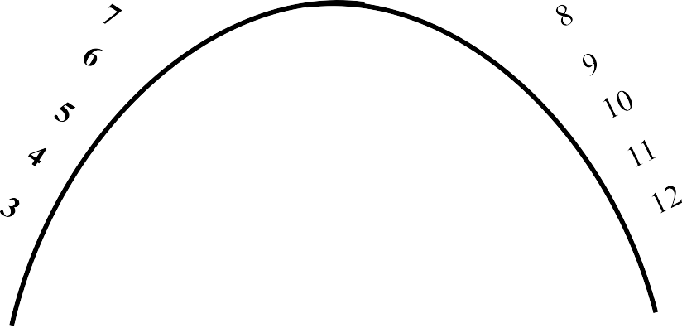


PARABOLA METHOD OF TANGENTS
Problem no.8: Draw an isosceles triangle of 100 mm long base and 110 mm long altitude.Inscribe a parabola in it by method of tangents.
Solution Steps:
C
Construct triangle as per the given
dimensions.
Divide it’s both sides in to same no.of equal parts.
Name the parts in ascending and descending manner, as shown.
4. Join 1-1, 2-2,3-3 and so on.
5. Draw the curve as shown i.e.tangent to all these lines. The above all lines being tangents to the curve, it is called method of tangents.
A
B

Slide 12
PARABOLA
DIRECTRIX-FOCUS METHOD
PROBLEM 9: Point F is 50 mm from a vertical straight line AB.
Draw locus of point P, moving in a plane such that
it always remains equidistant from point F and line AB.
SOLUTION STEPS:
Locate center of line, perpendicular to AB from point F. This will be initial point P and also the vertex.
Mark 5 mm distance to its right side, name those points 1,2,3,4 and from
those
draw lines parallel to AB.
Mark 5 mm distance to its left of P and name it 1.
Take O-1 distance as radius and F as center draw an arc
cutting first parallel line to AB. Name upper point P₁ and lower point P₂.
(FP₁=O1)
Similarly repeat this process by taking again 5mm to right and left and locate P₃P₄.
Join all these points in smooth curve.
PARABOLA
A
P₁
(VERTEX) _{V}
O
F
1 2 3 4
( focus)
P₂
B
It will be the locus of P equidistance from line AB and fixed point F.

Slide 13
HYPERBOLA
Problem No.10: Point P is 40 mm and 30 mm from horizontal and vertical axes respectively.Draw Hyperbola through it.
THROUGH A POINT
OF KNOWN CO-ORDINATES
Solution Steps:
Extend horizontal line from P to right side.
Extend vertical line from P upward.
On horizontal line from P, mark some points taking any distance and name them after P-1, 2,3,4 etc.
Join 1-2-3-4 points to pole O. Let them cut part [P-B] also at 1,2,3,4 points.
From horizontal 1,2,3,4 draw vertical lines downwards and
From vertical 1,2,3,4 points [from P-B] draw
2
1
2 1
P
1
2
3
1
horizontal lines.
7) Line from 1 horizontal and line from 1 vertical will meet at
40 mm
2
3
P₁.Similarly mark P₂, P₃, P₄ points.
8) Repeat the procedure by marking four points on upward vertical line from P and joining all those to pole O. Name this points P₆, P₇, P₈ etc. and join them by smooth curve.
O
30 mm

Slide 14
HYPERBOLA P-V DIAGRAM
Problem no.11: A sample of gas is expanded in a cylinder from 10 unit pressure to 1 unit pressure.Expansion follows law PV=Constant.If initial volume being 1 unit, draw the curve of expansion. Also Name the curve.
Form a table giving few more values of P & V
10
9
8
7
6
5
4
3
2
1
P | V = | C
10 | 1 = | 10
5 | 2 = | 10
4 | 2.5 = | 10
2.5 | 4 = | 10
2 | 5 = | 10
1 | 10 = | 10
Now draw a Graph of Pressure against Volume.
It is a PV Diagram and it is Hyperbola. Take pressure on vertical axis and Volume on horizontal axis.
PRESSURE
( Kg/cm²)
0
1 2 3 4 5 6 7 8 9
VOLUME:( M³ )
10

Slide 15
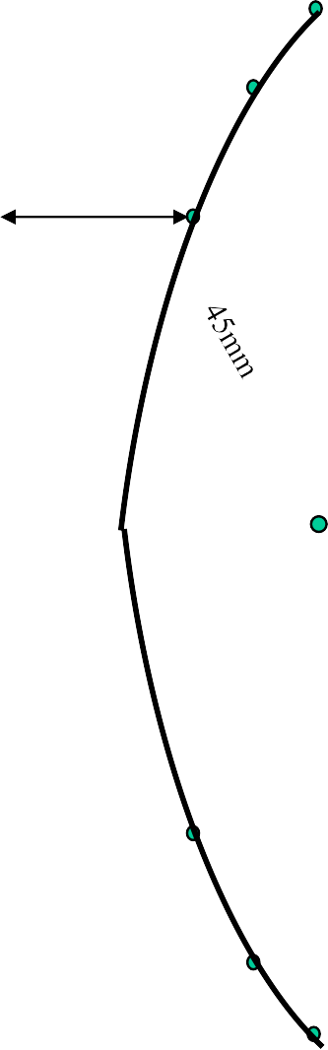
HYPERBOLA DIRECTRIX
FOCUS METHOD
PROBLEM 12:- POINT F IS 50 MM FROM A LINE AB.A POINT P IS MOVING IN A PLANE SUCH THAT THE RATIO OF IT’S DISTANCES FROM F AND LINE AB REMAINS CONSTANT AND EQUALS TO 2/3 DRAW LOCUS OF POINT P. { ECCENTRICITY = 2/3 }
STEPS:
.Draw a vertical line AB and point F 50 mm from it.
.Divide 50 mm distance in 5 parts.
.Name 2nd part from F as V. It is 20mm and 30mm from F and AB line resp.
It is first point giving ratio of it’s distances from F and AB 2/3 i.e 20/30
Form more points giving same ratio such as 30/45, 40/60, 50/75 etc.
Taking 45,60 and 75mm distances from line AB, draw three vertical lines to the right side of it.
Now with 30, 40 and 50mm distances in compass cut these lines above and below, with F as center.
Join these points through V in smooth curve.
This is required locus of P.It is an ELLIPSE.
A
30mm
(vertex)
F ( focus)
V
B

Slide 16
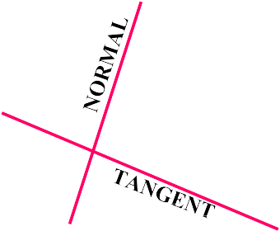
ELLIPSE
TANGENT & NORMAL
TO DRAW TANGENT & NORMAL
Problem 13:
TO THE CURVE FROM A GIVEN POINT ( Q )
JOIN POINT Q TO F₁ & F₂
BISECT ANGLE F₁Q F₂ THE ANGLE BISECTOR IS NORMAL
A PERPENDICULAR LINE DRAWN TO IT IS TANGENT TO THE CURVE.
p₄
C
p₃
p₂
p₁
A
B
F₁
1 2 3 4
O
F₂
Q
D

Slide 17

ELLIPSE
TANGENT & NORMAL
Problem 14:
TO DRAW TANGENT & NORMAL TO THE CURVE
FROM A GIVEN POINT ( Q )
ELLIPSE
A
JOIN POINT Q TO F.
CONSTRUCT 900 ANGLE WITH THIS LINE AT POINT F
EXTEND THE LINE TO MEET DIRECTRIX AT T
JOIN THIS POINT TO Q AND EXTEND. THIS IS TANGENT TO ELLIPSE FROM Q
TO THIS TANGENT DRAW PERPENDICULAR
LINE FROM Q. IT IS NORMAL TO CURVE.
T
(vertex) V
F ( focus)
90⁰
N
Q
N
B
T

Slide 18
PARABOLA TANGENT & NORMAL
Problem 15:
TO DRAW TANGENT & NORMAL
TO THE CURVE FROM A GIVEN POINT ( Q )
T
PARABOLA
A
JOIN POINT Q TO F.
CONSTRUCT 90⁰ ANGLE WITH THIS LINE AT POINT F
EXTEND THE LINE TO MEET DIRECTRIX AT T
JOIN THIS POINT TO Q AND EXTEND. THIS IS TANGENT TO THE CURVE FROM Q
TO THIS TANGENT DRAW PERPENDICULAR
LINE FROM Q. IT IS NORMAL TO CURVE.
VERTEX V _{F}
90⁰
( focus)
N
Q
B
N
T

Slide 19
HYPERBOLA TANGENT & NORMAL
Problem 16
TO DRAW TANGENT & NORMAL
TO THE CURVE FROM A GIVEN POINT ( Q )
A
JOIN POINT Q TO F.
CONSTRUCT 90⁰ ANGLE WITH THIS LINE AT POINT F
EXTEND THE LINE TO MEET DIRECTRIX AT T
JOIN THIS POINT TO Q AND EXTEND. THIS IS TANGENT TO CURVE FROM Q
TO THIS TANGENT DRAW PERPENDICULAR LINE FROM Q. IT IS NORMAL TO CURVE.
T
(vertex)
F ( focus)
V
90⁰
N
N Q
B
T

Slide 20
CYCLOID
PROBLEM 22: DRAW LOCUS OF A POINT ON THE PERIPHERY OF A CIRCLE
WHICH ROLLS ON STRAIGHT LINE PATH. Take Circle diameter as 50 mm
4
p₄
3
5
p₃
p₅
C p₂
C₁
C₂
C₃
C₄
C₅
C₆
C₇
p₆
C₈
2
6
p₁
1
7
p₇
P
p₈
πD
Solution Steps:
From center C draw a horizontal line equal to πD distance.
Divide πD distance into 8 number of equal parts and name them C1, C2, C3 etc.
Divide the circle also into 8 number of equal parts and in clock wise direction, after P name 1, 2, 3 up to 8.
From all these points on circle draw horizontal lines. (parallel to locus of C)
With a fixed distance C-P in compass, C1 as center, mark a point on horizontal line from 1. Name it P.
Repeat this procedure from C2, C3, C4 upto C8 as centers. Mark points P2, P3, P4, P5 up to P8 on the
horizontal lines drawn from 2, 3, 4, 5, 6, 7 respectively.
Join all these points by curve. It is Cycloid.

Slide 21
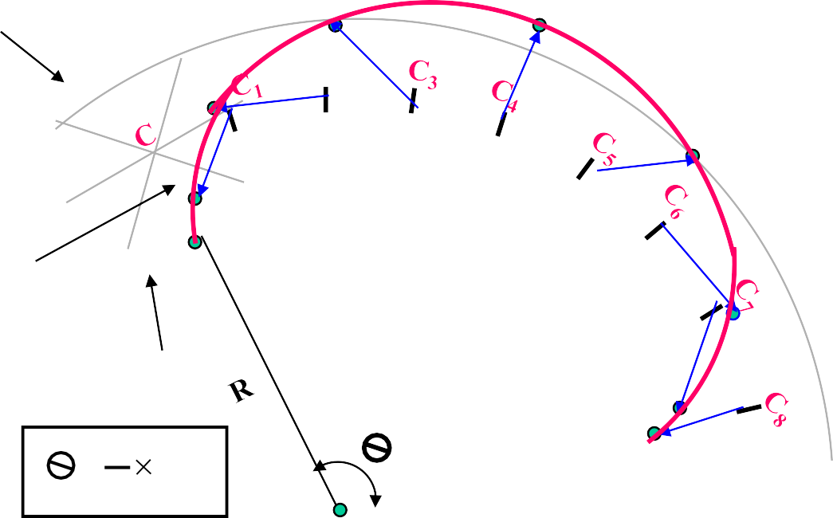
PROBLEM 25: DRAW LOCUS OF A POINT ON THE PERIPHERY OF A CIRCLE
WHICH ROLLS ON A CURVED PATH. Take diameter of rolling Circle 50 mm And radius of directing circle i.e. curved path, 75 mm.
EPI CYCLOID :
Solution Steps:
When smaller circle will roll on larger circle for one revolution it will cover Π D distance on arc and it will be decided by included arc angle θ.
Calculate θ by formula θ = (r/R) x 3600.
Construct angle θ with radius OC
and draw an arc by taking O as center OC as radius and form sector of angle
θ.
Divide this sector into 8 number of equal angular parts. And from C onward name them C1, C2, C3 up to C8.
Divide smaller circle (Generating circle) also in 8 number of equal parts. And next to P in clockwise direction name those 1, 2, 3, up to 8.
With O as center, O-1 as radius draw an arc in the sector. Take O-2, O- 3, O-4, O-5 up to O-8 distances with center O, draw all concentric arcs in sector. Take fixed distance C-P in compass, C1 center, cut arc of 1 at P1. Repeat procedure and locate P2, P3, P4, P5 unto P8 (as in cycloid) and join them by smooth curve. This is EPI – CYCLOID.
Generating/ Rolling Circle₄
5
C₂
3
6
7
2
r = CP
1
P
Directing Circle
₌ r
360⁰
R
O

Slide 22
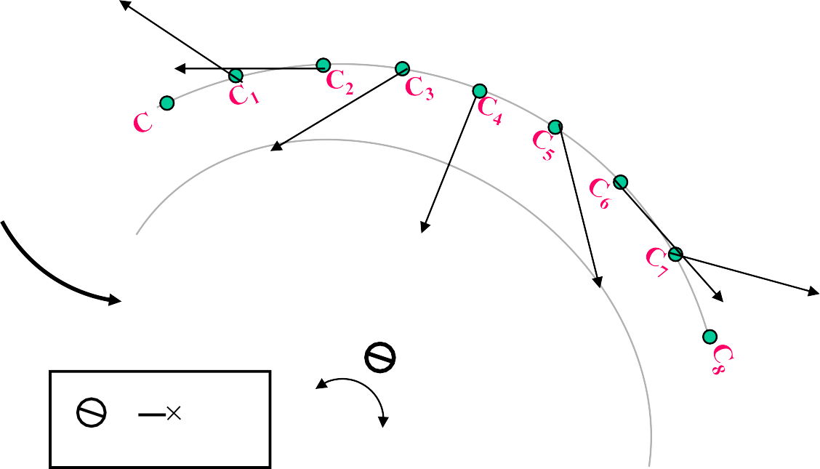
HYPO CYCLOID
PROBLEM 26: DRAW LOCUS OF A POINT ON THE PERIPHERY OF A CIRCLE WHICH ROLLS FROM THE INSIDE OF A CURVED PATH. Take diameter of
rolling circle 50 mm and radius of directing circle (curved path) 75 mm.
Solution Steps:
Smaller circle is rolling
here, inside the larger circle. It has to rotate anticlockwise to move ahead.
Same steps should be taken as in case of EPI – CYCLOID. Only change is in numbering direction of 8 number of equal parts on the smaller circle.
From next to P in anticlockwise direction, name 1,2,3,4,5,6,7,8.
Further all steps are that of epi – cycloid. This is called
HYPO – CYCLOID.
P
7
P₁
6
1
P₂
P
5
2
3
3
4
P
4
P
P₈
5
P₆
P₇
r
360⁰
= _{R}
O
OC = R ( Radius of Directing Circle) CP = r (Radius of Generating Circle)

Slide 23


CYCLOID
Method of Drawing Tangent & Normal
STEPS:
DRAW CYCLOID AS USUAL.
MARK POINT Q ON IT AS DIRECTED.
WITH CP DISTANCE, FROM Q. CUT THE POINT ON LOCUS OF C AND JOIN IT TO Q.
FROM THIS POINT DROP A PERPENDICULAR ON GROUND LINE AND NAME IT N
JOIN N WITH Q.THIS WILL BE NORMAL TO
CYCLOID.
DRAW A LINE AT RIGHT ANGLE TO THIS LINE FROM Q.
IT WILL BE TANGENT TO CYCLOID.
CYCLOID
Q
C
C₁
C₂
C₃
C₄
C₅
C₆
C₇
C₈
P
N
πD

Slide 24
SCALES
DIMENSIONS OF LARGE OBJECTS MUST BE REDUCED TO ACCOMMODATE ON STANDARD SIZE DRAWING SHEET.THIS REDUCTION CREATES A SCALE OF THAT REDUCTION RATIO, WHICH IS GENERALLY A FRACTION..
SUCH A SCALE IS CALLED REDUCING SCALE AND
THAT RATIO IS CALLED REPRESENTATIVE FACTOR.
FOR FULL SIZE SCALE R.F.=1 OR ( 1:1 ) MEANS DRAWING
& OBJECT ARE OF
SAME SIZE.
Other RFs are described as
1:10, 1:100,
1:1000, 1:1,00,000
SIMILARLY IN CASE OF TINY OBJECTS DIMENSIONS MUST BE INCREASED FOR ABOVE PURPOSE. HENCE THIS SCALE IS CALLED ENLARGING SCALE. HERE THE RATIO CALLED REPRESENTATIVE FACTOR IS MORE THAN UNITY.
USE FOLLOWING FORMULAS FOR THE CALCULATIONS IN THIS TOPIC.
A
DIMENSION OF DRAWING
REPRESENTATIVE FACTOR (R.F.) =
DIMENSION OF OBJECT
₌ LENGTH OF DRAWING ACTUAL LENGTH
₌ AREA OF DRAWING
V ACTUAL AREA
₌ ₃ VOLUME AS PER DRWG. V ACTUAL VOLUME
B LENGTH OF SCALE = R.F. X MAX. LENGTH TO BE MEASURED.

Slide 25
BE FRIENDLY WITH THESE UNITS.
1 KILOMETRE = 10 HECTOMETRES
1 HECTOMETRE = 10 DECAMETRES
1 DECAMETRE
1 METRE
1 DECIMETRE
1 CENTIMETRE
= 10 METRES
= 10 DECIMETRES
= 10 CENTIMETRES
= 10 MILIMETRES
TYPES OF SCALES:
PLAIN SCALES
DIAGONAL SCALES
VERNIER SCALES
COMPARATIVE SCALES ( FOR COMPARING TWO DIFFERENT UNITS)
SCALE OF CORDS ( FOR MEASURING/CONSTRUCTING ANGLES)
( FOR DIMENSIONS UP TO SINGLE DECIMAL) ( FOR DIMENSIONS UP TO TWO DECIMALS)
( FOR DIMENSIONS UP TO TWO DECIMALS)

Slide 26
PLAIN SCALE:-This type of scale represents two units or a unit and it‟s sub-division.
PROBLEM NO.1:- Draw a scale 1 cm = 1m to read decimeters, to measure maximum distance of 6 m.
Show on it a distance of 4 m and 6 dm.
CONSTRUCTION:-
a) Calculate R.F.=
DIMENSION OF DRAWING
DIMENSION OF OBJECT
PLAIN SCALE
R.F.= 1cm/ 1m = 1/100
Length of scale = R.F. X max. distance
= 1/100 X 600 cm
= 6 cms
Draw a line 6 cm long and divide it in 6 equal parts. Each part will represent larger division unit.
Sub divide the first part which will represent second unit or fraction of first unit.
Place ( 0 ) at the end of first unit. Number the units on right side of Zero and subdivisions on left-hand side of Zero. Take height of scale 5 to 10 mm for getting a look of scale.
After construction of scale mention it’s RF and name of scale as shown.
Show the distance 4 m 6 dm on it as shown.
4 M 6 DM
10
DECIMETERS
0
1 2 3
R.F. = 1/100
PLANE SCALE SHOWING METERS AND DECIMETERS.
4
5
METERS

Slide 27
PROBLEM NO.2:- In a map a 36 km distance is shown by a line 45 cms long. Calculate the R.F. and construct
a plain scale to read kilometers and hectometers, for max. 12 km. Show a distance of 8.3 km on it.
CONSTRUCTION:-
a) Calculate R.F.
PLAIN SCALE
R.F.= 45 cm/ 36 km = 45/ 36 . 1000 . 100 = 1/ 80,000
Length of scale = R.F. max. distance
= 1/ 80000 12 km
= 15 cm
Draw a line 15 cm long and divide it in 12 equal parts. Each part will represent larger division unit.
Sub divide the first part which will represent second unit or fraction of first unit.
Place ( 0 ) at the end of first unit. Number the units on right side of Zero and subdivisions on left-hand side of Zero. Take height of scale 5 to 10 mm for getting a look of scale.
After construction of scale mention it’s RF and name of scale as shown.
Show the distance 8.3 km on it as shown.
8KM 3HM
10
5
0
1
2 3 4 5 6 7 8 9
R.F. = 1/80,000
PLANE SCALE SHOWING KILOMETERS AND HECTOMETERS
10
11
KILOMETERS
HECTOMETERS

Slide 28
PROBLEM NO.3:- The distance between two stations is 210 km. A passenger train covers this distance
in 7 hours. Construct a plain scale to measure time up to a single minute. RF is 1/200,000 Indicate the distance traveled by train in 29 minutes.
CONSTRUCTION:-
a) 210 km in 7 hours. Means speed of the train is 30 km per hour ( 60 minutes)
PLAIN SCALE
Length of scale = R.F. max. distance per hour
= 1/ 2,00,000 30km
= 15 cm
15 cm length will represent 30 km and 1 hour i.e. 60 minutes.
Draw a line 15 cm long and divide it in 6 equal parts. Each part will represent 5 km and 10 minutes.
Sub divide the first part in 10 equal parts,which will represent second unit or fraction of first unit. Each smaller part will represent distance traveled in one minute.
Place ( 0 ) at the end of first unit. Number the units on right side of Zero and subdivisions on left-hand side of Zero. Take height of scale 5 to 10 mm for getting a proper look of scale.
Show km on upper side and time in minutes on lower side of the scale as shown.
After construction of scale mention it’s RF and name of scale as shown.
Show the distance traveled in 29 minutes, which is 14.5 km, on it as shown.
DISTANCE TRAVELED IN 29 MINUTES.
14.5 KM
2.5 0 5
KM
5
10
15
20
25 KM
MIN
10
0
10 20 30
R.F. = 1/100
PLANE SCALE SHOWING METERS AND DECIMETERS.
40
50 MINUTES

Slide 29



DIAGONAL SCALE
We have seen that the plain scales give only two dimensions, such as a unit and it‟s subunit or it‟s fraction.
The diagonal scales give us three successive dimensions that is a unit, a subunit and a subdivision of a subunit.
The principle of construction of a diagonal scale is as follows.
Let the XY in figure be a subunit.
From Y draw a perpendicular YZ to a suitable height. Join XZ. Divide YZ in to 10 equal parts.
Draw parallel lines to XY from all these divisions and number them as shown.
From geometry we know that similar triangles have
their like sides proportional.
X
Y
10
9
8
7
6
5
4
3
2
1
Consider two similar triangles XYZ and 7’ 7Z,
we have 7Z / YZ = 7’7 / XY (each part being one unit) Means 7’ 7 = 7 / 10. x X Y = 0.7 XY
:.
Similarly
1’ – 1 = 0.1 XY
2’ – 2 = 0.2 XY
Thus, it is very clear that, the sides of small triangles, which are parallel to divided lines, become progressively shorter in length by 0.1 XY.
Z
The solved examples ON NEXT PAGES will make the principles of diagonal scales clear.

Slide 30

PROBLEM NO. 4 : The distance between Delhi and Agra is 200 km.
In a railway map it is represented by a line 5 cm long. Find it’s R.F. Draw a diagonal scale to show single km. And maximum 600 km.
Indicate on it following distances. 1) 222 km 2) 336 km 3) 459 km 4) 569 km
DIAGONAL SCALE
SOLUTION STEPS:
RF = 5 cm / 200 km = 1 / 40, 00, 000
Length of scale = 1 / 40, 00, 000 X 600 X 10⁵ = 15 cm
Draw a line 15 cm long. It will represent 600 km.Divide it in six equal parts.( each will represent 100 km.)
Divide first division in ten equal parts.Each will represent 10 km.Draw a line upward from left end and
mark 10 parts on it of any distance. Name those parts 0 to 10 as shown.Join 9th sub-division of horizontal scale with 10th division of the vertical divisions. Then draw parallel lines to this line from remaining sub divisions and complete diagonal scale.
569 km
459 km
336 km
222 km
10
9
8
7
6
5
4
3
2
1
KM
0
50
200
R.F. = 1 / 40,00,000
^{KM} 100
0
100
300
400
500 KM
DIAGONAL SCALE SHOWING KILOMETERS.

Slide 31



DIAGONAL
PROBLEM NO.5: A rectangular plot of land measuring 1.28 hectors is represented on a map by a similar rectangle of 8 sq. cm. Calculate RF of the scale. Draw a diagonal scale to read single meter. Show a distance of 438 m on it.
SOLUTION :
1 hector = 10, 000 sq. meters
1.28 hectors = 1.28 X 10, 000 sq. meters
= 1.28 X 10⁴ X 10⁴ sq. cm
8 sq. cm area on map represents
= 1.28 X 10⁴ X 10⁴ sq. cm on land 1 cm sq. on map represents
= 1.28 X 10 ⁴ X 10⁴ / 8 sq cm on land 1 cm on map represent
= 1.28 X 10 ⁴ X 10⁴ / 8 cm
= 4, 000 cm
1 cm on drawing represent 4, 000 cm, Means RF = 1 / 4000 Assuming length of scale 15 cm, it will represent 600 m.
SCALE
Draw a line 15 cm long.
It will represent 600 m.Divide it in six equal parts. ( each will represent 100 m.)
Divide first division in ten equal parts.Each will represent 10 m.
Draw a line upward from left end and mark 10 parts on it of any distance.
Name those parts 0 to 10 as shown.Join 9th sub-division
of horizontal scale with 10th division of the vertical divisions. Then draw parallel lines to this line from remaining sub divisions and complete diagonal scale.
438 meters
10
9
8
7
6
5
4
3
2
1
0
M
M 100
50
0
100
200
R.F. = 1 / 4000
300
400
500 M
DIAGONAL SCALE SHOWING METERS.

Slide 32




PROBLEM NO.6:. Draw a diagonal scale of R.F. 1: 2.5, showing centimeters and millimeters and long enough to measure up to 20 centimeters.
SOLUTION STEPS:
R.F. = 1 / 2.5
Length of scale = 1 / 2.5 X 20 cm.
= 8 cm.
Draw a line 8 cm long and divide it in to 4 equal parts. (Each part will represent a length of 5 cm.)
Divide the first part into 5 equal divisions. (Each will show 1 cm.)
At the left hand end of the line, draw a vertical line and on it step-off 10 equal divisions of any length.
Complete the scale as explained in previous problems.
Show the distance 13.4 cm on it.
DIAGONAL SCALE
13 .4 CM
10
9
8
7
6
5
4
3
2
1
MM
0
5 4
3
2 1 0 5 10
R.F. = 1 / 2.5
DIAGONAL SCALE SHOWING CENTIMETERS.
CM
15 CENTIMETRES

Slide 33
ORTHOGRAPHIC PROJECTIONS:
IT IS A TECHNICAL DRAWING IN WHICH DIFFERENT VIEWS OF AN OBJECT
ARE PROJECTED ON DIFFERENT REFERENCE PLANES OBSERVING PERPENDICULAR TO RESPECTIVE REFERENCE PLANE
Different Reference planes are
Horizontal Plane (HP), Vertical Frontal Plane ( VP )
Side Or Profile Plane ( PP)
And
Different Views are Front View (FV), Top View (TV) and Side View (SV)
FV is a view projected on VP. TV is a view projected on HP. SV is a view projected on PP.
IMPORTANT TERMS OF ORTHOGRAPHIC PROJECTIONS:
1
Planes.
2
Pattern of planes & Pattern of views
3 Methods of drawing Orthographic Projections

Slide 34




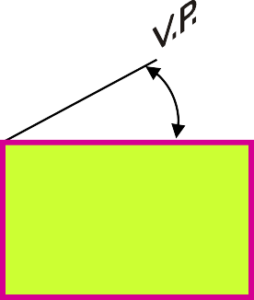

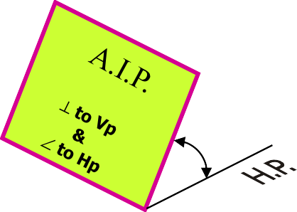

PLANES
1
PRINCIPAL PLANES
HP AND VP
AUXILIARY PLANES
Auxiliary Vertical Plane (A.V.P.)
Auxiliary Inclined Plane
(A.I.P.)
Profile Plane ( P.P.)

A.V.P.
⊥ to Hp & ∠ to Vp


Slide 35
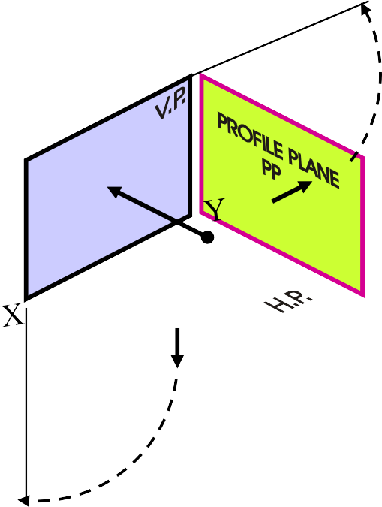
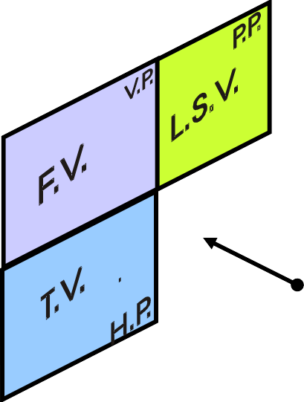
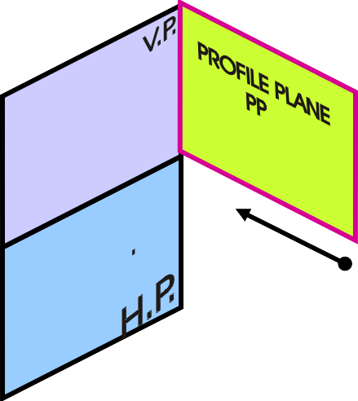
2
PATTERN OF PLANES & VIEWS (First Angle Method)
THIS IS A PICTORIAL SET-UP OF ALL THREE PLANES.
ARROW DIRECTION IS A NORMAL WAY OF OBSERVING THE OBJECT. BUT IN THIS DIRECTION ONLY VP AND A VIEW ON IT (FV) CAN BE SEEN. THE OTHER PLANES AND VIEWS ON THOSE CAN NOT BE SEEN.
PROCEDURE TO SOLVE ABOVE PROBLEM:-
TO MAKE THOSE PLANES ALSO VISIBLE FROM THE ARROW DIRECTION,
HP IS ROTATED 90⁰ DOUNWARD
PP, 90⁰ IN RIGHT SIDE DIRECTION.
THIS WAY BOTH PLANES ARE BROUGHT IN THE SAME PLANE CONTAINING VP.
Click to view Animation
On clicking the button if a warning comes please click YES to continue, this program is safe for your pc.
Y
VP
PP
FV
LSV
X
Y
X
HP
TV
ACTUAL PATTERN OF PLANES & VIEWS OF ORTHOGRAPHIC PROJECTIONS DRAWN IN
FIRST ANGLE METHOD OF PROJECTIONS
HP IS ROTATED DOWNWARD 90⁰ AND
BROUGHT IN THE PLANE OF VP.
PP IS ROTATED IN RIGHT SIDE 90⁰
AND
BROUGHT IN THE PLANE OF VP.

Slide 36
Methods of Drawing Orthographic Projections
3
First Angle Projections Method
Here views are drawn by placing object
in 1st Quadrant
( Fv above X-y, Tv below X-y )
Third Angle Projections Method
Here views are drawn by placing object
in 3rd Quadrant.
( Tv above X-y, Fv below X-y )
SYMBOLIC
PRESENTATION OF BOTH METHODS WITH AN OBJECT
STANDING ON HP ( GROUND) ON IT’S BASE.
NOTE:-
HP term is used in 1st Angle method &
For the same
Ground term is used
in 3rd Angle method of projections
FV
TV
X
Y
X
Y
TV
FV
G
L

Slide 37
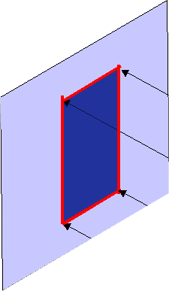
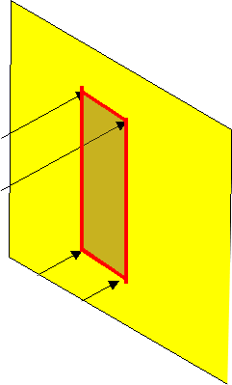
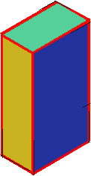

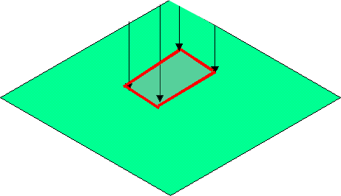
FIRST ANGLE PROJECTION
FOR T.V.
IN THIS METHOD,
THE OBJECT IS ASSUMED TO BE SITUATED IN FIRST QUADRANT MEANS
ABOVE HP & INFRONT OF VP.
OBJECT IS INBETWEEN OBSERVER & PLANE.
VP
PP
FV
LSV
X
Y
HP
TV
ACTUAL PATTERN OF PLANES & VIEWS
IN
FIRST ANGLE METHOD OF PROJECTIONS

Slide 38


THIRD ANGLE PROJECTION
FOR T.V.
IN THIS METHOD,
THE OBJECT IS ASSUMED TO BE SITUATED IN THIRD QUADRANT ( BELOW HP & BEHIND OF VP. )
PLANES BEING TRANSPERENT
AND INBETWEEN OBSERVER & OBJECT.
TV
X
Y
LSV
FV
ACTUAL PATTERN OF PLANES & VIEWS
OF
THIRD ANGLE PROJECTIONS

Slide 39



ORTHOGRAPHIC PROJECTIONS
OF POINTS, LINES, PLANES, AND SOLIDS.
TO DRAW PROJECTIONS OF ANY OBJECT, ONE MUST HAVE FOLLOWING INFORMATION
OBJECT
{ WITH IT‟S DESCRIPTION, WELL DEFINED.}
OBSERVER
{ ALWAYS OBSERVING PERPENDICULAR TO RESP. REF.PLANE}.
LOCATION OF OBJECT,
{ MEANS IT‟S POSITION WITH REFFERENCE TO H.P. & V.P.}
TERMS „ABOVE‟ & „BELOW‟ WITH RESPECTIVE TO H.P. AND TERMS „INFRONT‟ & „BEHIND‟ WITH RESPECTIVE TO V.P
FORM 4 QUADRANTS.
OBJECTS CAN BE PLACED IN ANY ONE OF THESE 4 QUADRANTS.
IT IS INTERESTING TO LEARN THE EFFECT ON THE POSITIONS OF VIEWS ( FV, TV ) OF THE OBJECT WITH RESP. TO X-Y LINE, WHEN PLACED IN DIFFERENT QUADRANTS.
STUDY ILLUSTRATIONS GIVEN ON HEXT PAGES AND NOTE THE RESULTS.TO MAKE IT EASY HERE A POINT A IS TAKEN AS AN OBJECT. BECAUSE IT’S ALL VIEWS ARE JUST POINTS.

Slide 40
NOTATIONS
FOLLOWING NOTATIONS SHOULD BE FOLLOWED WHILE NAMEING DIFFERENT VIEWS IN ORTHOGRAPHIC PROJECTIONS.
OBJECT | POINT | A | LINE AB
IT‟S TOP VIEW IT‟S FRONT VIEW IT‟S SIDE VIEW | a a‟ a” | a b a‟ b‟ a” b”
SAME SYSTEM OF NOTATIONS SHOULD BE FOLLOWED
INCASE NUMBERS, LIKE 1, 2, 3 – ARE USED.

Slide 41




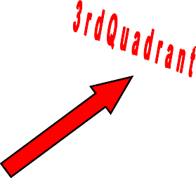





VP
₂nd
Quad.
1ST Quad.
Y
Observer
X Y
HP
X
₃rd
Quad.
4th Quad.
THIS QUADRANT PATTERN,
IF OBSERVED ALONG X-Y LINE ( IN RED ARROW DIRECTION) WILL EXACTLY APPEAR AS SHOWN ON RIGHT SIDE AND HENCE,
IT IS FURTHER USED TO UNDERSTAND ILLUSTRATION PROPERLLY.

Slide 42
Point A is Placed In different quadrants
and it‟s Fv & Tv are brought in same plane for Observer to see clearly.
Fv is visible as it is a view on VP. But as Tv is is a view on Hp, it is rotated downward 90⁰, In clockwise direction.The
In front part of
POINT A IN 2ND QUADRANT
A
VP
a’
POINT A IN 1ST QUADRANT
VP
A
a’
a
HP
OBSERVER
HP
OBSERVER
a
a
Hp comes below
xy line and the part behind Vp comes above.
HP
HP
OBSERVER
OBSERVER
Observe and note the process.
a
a’
a’
A
POINT A IN
A
POINT A IN
₃RD
QUADRANT
VP
₄TH
QUADRANT
VP

Slide 43
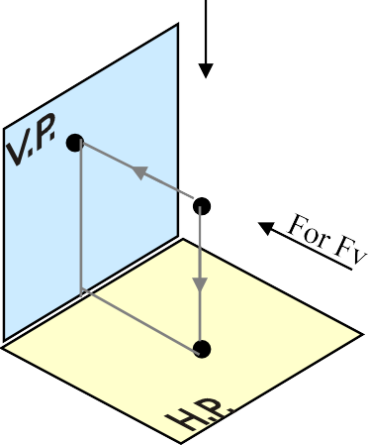
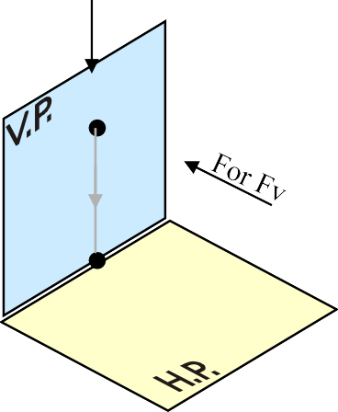
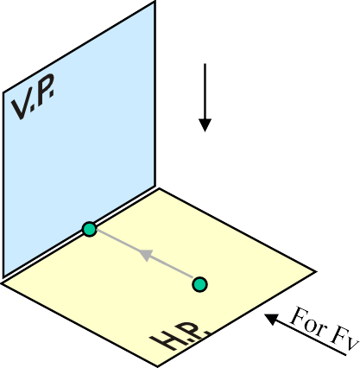



PROJECTIONS OF A POINT IN FIRST QUADRANT.
POINT A ABOVE HP & INFRONT OF VP
POINT A ABOVE HP & IN VP
POINT A IN HP & INFRONT OF VP
For Tv
For Tv
PICTORIAL PRESENTATION
PICTORIAL PRESENTATION
For Tv
a’
a’ ^{A}
A
Y
Y
Y
a
a’
X
a
A
a
X
X
ORTHOGRAPHIC PRESENTATIONS OF ALL ABOVE CASES.
Fv above xy, Tv below xy.
Fv above xy, Tv on xy.
Fv on xy, Tv below xy.
VP
VP
VP
a’
a’
X
Y
X
Y
X
a’
Y
a
a
a
HP
HP
HP

Slide 44
PROJECTIONS OF STRAIGHT LINES.
INFORMATION REGARDING A LINE means
IT‟S LENGTH,
POSITION OF IT‟S ENDS WITH HP & VP
IT‟S INCLINATIONS WITH HP & VP WILL BE GIVEN. AIM:- TO DRAW IT‟S PROJECTIONS - MEANS FV & TV.
SIMPLE CASES OF THE LINE
A VERTICAL LINE ( LINE PERPENDICULAR TO HP & // TO VP)
LINE PARALLEL TO BOTH HP & VP.
LINE INCLINED TO HP & PARALLEL TO VP.
LINE INCLINED TO VP & PARALLEL TO HP.
LINE INCLINED TO BOTH HP & VP.
STUDY ILLUSTRATIONS GIVEN ON NEXT PAGE SHOWING CLEARLY THE NATURE OF FV & TV OF LINES LISTED ABOVE AND NOTE RESULTS.

Slide 45



For Tv
Orthographic Pattern
(Pictorial Presentation)
a’
Note:
Fv is a vertical line Showing True Length &
Tv is a point.
V.P.
a’
1.
A
Fv
FV
A Line perpendicular to Hp
&
// to Vp
b’
b’
Y
X
Y
B
TV
a b
X
Tv a b
H.P.
Orthographic Pattern
(Pictorial Presentation)
2.
Note:
Fv & Tv both are
// to xy &
both show T. L.
V.P.
For Tv
a’
Fv
b’
A Line
// to Hp &
// to Vp
b’
B
a’
A
Y
X
Y
b
a
b
Tv
X
a
H.P.

Slide 46




Fv inclined to xy Tv parallel to xy.
V.P.
3.
A Line inclined to Hp and
parallel to Vp
(Pictorial presentation)
X
b’
b’
B
a’
θ
θ
Y
X
Y
a’
θ
a
A
b
T.V.
b
a
H.P.
Orthographic Projections
Tv inclined to xy Fv parallel to xy.
V.P.
4.
A Line inclined to Vp
and
parallel to Hp
(Pictorial presentation)
b’
a’
Fv
b’
a’
A
Ø
B
X
Y
a
Ø
a
Ø
b
Tv
b
H.P.

Slide 47


For Tv
For Tv
5.
A Line inclined to both
Hp and Vp
(Pictorial presentation)
b’
b’
B
B
α
α
Y
Y
a’
On removal of object
i.e. Line AB
Fv as a image on Vp. Tv as a image on Hp,
a’
A
A
β
X
β
X
a
T.V.
b
a
T.V.
b
V.P.
b’
FV
α
a’
X
Y
Orthographic Projections
Fv is seen on Vp clearly.
To see Tv clearly, HP is rotated 90⁰ downwards, Hence it comes below xy.
Note These Facts:-
Both Fv & Tv are inclined to xy.
(No view is parallel to xy)
Both Fv & Tv are reduced lengths. (No view shows True Length)
a
β
TV
H.P.
b

Slide 48
Orthographic Projections Means Fv & Tv of Line AB are shown below,
with their apparent Inclinations
α & β
Note the procedure When Fv & Tv known, How to find True Length.
(Views are rotated to determine True Length & it‟s inclinations with Hp & Vp).
Note the procedure When True Length is known,
How to locate Fv & Tv. (Component a-1 of TL is drawn which is further rotated
to determine Fv)
V.P.
V.P.
V.P.
b’
b’
b ’
b’
_{b1}’
1
FV
a’ α
FV
TL
a’
θ
α
a’
θ
1’
X
Y
X
Y
X
Y
a
1
a
β
a
β
TV
b₂
Ø
β
TV
TV
H.P.
b
H.P.
b
H.P.
b
b₁
Here TV (ab) is not // to XY line Hence it’s corresponding FV a’ b’ is not showing
True Length & True Inclination with Hp.
In this sketch, TV is rotated
and made // to XY line. Hence it’s corresponding FV a’ b₁’ Is showing
True Length &
True Inclination with Hp.
Here a -1 is component of TL ab₁ gives length of Fv. Hence it is brought Up to
Locus of a’ and further rotated to get point b’. a’ b’ will be Fv.
Similarly drawing component
of other TL(a‟ b₁„) Tv can be drawn.

Slide 49






The most important diagram showing graphical relations among all important parameters of this topic.
Study and memorize it as a CIRCUIT DIAGRAM
And use in solving various problems.
V.P.
1) True Length ( TL) – a’ b₁’ & a b
Angle of TL with Hp - θ ^{Important} Angle of TL with Vp – Ø ^{TEN parameters} to be remembered Angle of FV with xy – α with Notations Angle of TV with xy – β ^{used here onward} LTV (length of FV) – Component (a-1) LFV (length of TV) – Component (a‟-1‟) Position of A- Distances of a & a‟ from xy Position of B- Distances of b & b‟ from xy Distance between End Projectors
Distance between End Projectors.
b’
_{b} ’
1
α
a’
θ
1’
LTV
NOTE this
θ & α Construct with a’
Ø & β Construct with a
X
Y
a
LFV
1
Ø
b’ & b₁’ on same locus. b & b₁ on same locus.
β
Also Remember
True Length is never rotated. It‟s horizontal component is drawn & it is further rotated to locate view.
H.P.
b
b
1
Views are always rotated, made horizontal & further extended to locate TL, θ & Ø

Slide 50
GROUP (A)
GENERAL CASES OF THE LINE INCLINED TO BOTH HP & VP
( based on 10 parameters).
PROBLEM 1)
Line AB is 75 mm long and it is 30⁰ & 40⁰ Inclined to Hp & Vp respectively. End A is 12mm above Hp and 10 mm in front of Vp.
Draw projections. Line is in 1st quadrant.
b’
b’₁
FV
SOLUTION STEPS:
Draw xy line and one projector.
Locate a‟ 12mm above xy line & a 10mm below xy line.
Take 30⁰ angle from a‟ & 40⁰ from a and mark TL I.e. 75mm on both lines. Name those points b₁‟ and b₁ respectively.
Join both points with a‟ and a resp.
Draw horizontal lines (Locus) from both points.
Draw horizontal component of TL a b₁ from point b₁ and name it 1.
( the length a-1 gives length of Fv as we have seen already.)
Extend it up to locus of a‟ and rotating a‟ as center locate b‟ as shown. Join a‟ b‟ as Fv.
From b‟ drop a projector down ward & get point b. Join a & b
I.e. Tv.
TL
θ
a’
X
Y
a
LFV
Ø
1
TV
TL
b b₁

Slide 51





PROBLEM 2:
Line AB 75mm long makes 45⁰ inclination with Vp while it’s Fv makes 55⁰. End A is 10 mm above Hp and 15 mm in front of Vp.If line is in 1st quadrant draw it’s projections and find it’s inclination with Hp.
b’
b’₁
LOCUS OF
Solution Steps:-
Draw x-y line.
Draw one projector for a‟ & a 3.Locate a’ 10mm above x-y & Tv a 15 mm below xy.
Draw a line 45⁰ inclined to xy from point a and cut TL 75 mm on it and name that point b₁ Draw locus from point b₁
Take 55⁰ angle from a’ for Fv above xy line.
Draw a vertical line from b₁
up to locus of a and name it 1. It is horizontal component of TL & is LFV.
Continue it to locus of a’ and rotate upward up to the line of Fv and name it b’.This a’ b’ line is Fv.
Drop a projector from b‟ on locus from point b₁ and name intersecting point b. Line a b is Tv of line AB.
Draw locus from b’ and from
a’ with TL distance cut point b₁‘
Join a’ b₁’ as TL and measure it‟s angle at a’.
It will be true angle of line with HP.
55⁰
a’
y
X
a
LFV ₁
LOCUS OF b
b
b₁

Slide 52



PROBLEM 3:
Fv of line AB is 50⁰ inclined to xy and measures 55 mm long while it’s Tv is 60⁰ inclined to xy line. If end A is 10 mm above Hp and 15 mm in front of Vp, draw it’s projections,find TL, inclinations of line
with Hp & Vp.
b’
b’₁
SOLUTION STEPS:
1.Draw xy line and one projector. 2.Locate a’ 10 mm above xy and a 15 mm below xy line.
3.Draw locus from these points. 4.Draw Fv 50⁰ to xy from a’ and mark b’ Cutting 55mm on it.
Similarly draw Tv 60⁰ to xy
from a & drawing projector from b’ Locate point b and join a b.
Then rotating views as shown, locate True Lengths ab₁ & a’b₁’ and their angles with Hp and Vp.
50⁰
θ
X
a’
y
a
Φ
60⁰
b₁
b

Slide 53


PROBLEM 4 :-
Line AB is 75 mm long .It‟s Fv and Tv measure 50 mm & 60 mm long respectively. End A is 10 mm above Hp and 15 mm in front of Vp. Draw projections of line AB if end B is in first quadrant.Find angle with Hp and Vp.
b’
b’₁
SOLUTION STEPS:
1.Draw xy line and one projector. 2.Locate a’ 10 mm above xy and a 15 mm below xy line.
3.Draw locus from these points. 4.Cut 60mm distance on locus of a’
& mark 1’ on it as it is LTV.
Similarly Similarly cut 50mm on
locus of a and mark point 1 as it is LFV.
From 1’ draw a vertical line upward and from a’ taking TL ( 75mm ) in compass, mark b’₁ point on it.
Join a’ b’₁ points.
Draw locus from b’₁
With same steps below get b₁ point and draw also locus from it.
Now rotating one of the components
I.e. a-1 locate b’ and join a’ with it to get Fv.
10. Locate tv similarly and measure
θ
LTV
1’
a’
X
Y
a
LFV
1
Φ
Angles θ
&
Φ
b₁
b

Slide 54


PROJECTIONS OF PLANES
In this topic various plane figures are the objects.
What is usually asked in the problem?
To draw their projections means F.V, T.V. & S.V.
What will be given in the problem?
Description of the plane figure.
It’s position with HP and VP.
In which manner it’s position with HP & VP will be described?
Inclination of it’s SURFACE with one of the reference planes will be given.
Inclination of one of it’s EDGES with other reference plane will be given
(Hence this will be a case of an object inclined to both reference Planes.)
Study the illustration showing
surface & side inclination given on next page.

Slide 55
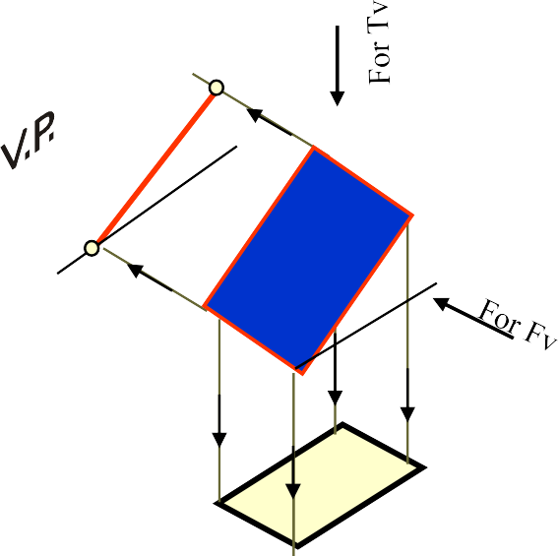















CASE OF A RECTANGLE – OBSERVE AND NOTE ALL STEPS.
SURFACE PARALLEL TO HP
PICTORIAL PRESENTATION
SURFACE INCLINED TO HP
PICTORIAL PRESENTATION
ONE SMALL SIDE INCLINED TO VP
PICTORIAL PRESENTATION
ORTHOGRAPHIC
TV-True Shape FV- Line // to xy
ORTHOGRAPHIC
FV- Inclined to XY TV- Reduced Shape
ORTHOGRAPHIC
FV- Apparent Shape TV-Previous Shape
VP
VP
VP
d₁’ c₁’
a’
d’
a₁’
b’
c’
b₁’
a
d
c
a₁
d₁
b
b₁
c₁
HP
A
HP
B
C
HP

Slide 56
PROCEDURE OF SOLVING THE PROBLEM:
IN THREE STEPS EACH PROBLEM CAN BE SOLVED:( As Shown In Previous Illustration )
STEP 1. Assume suitable conditions & draw Fv & Tv of initial position. STEP 2. Now consider surface inclination & draw 2nd Fv & Tv.
STEP 3. After this,consider side/edge inclination and draw 3rd ( final) Fv & Tv.
ASSUMPTIONS FOR INITIAL POSITION:
(Initial Position means assuming surface // to HP or VP)
If in problem surface is inclined to HP – assume it // HP Or If surface is inclined to VP – assume it // to VP
Now if surface is assumed // to HP- It’s TV will show True Shape. And If surface is assumed // to VP – It’s FV will show True Shape.
Hence begin with drawing TV or FV as True Shape.
While drawing this True Shape –
keep one side/edge ( which is making inclination) perpendicular to xy line
( similar to pair no. on previous page illustration ).
A
Now Complete STEP 2. By making surface inclined to the resp plane & project it‟s other view.
(Ref. 2nd pair on previous page illustration )
B
Now Complete STEP 3. By making side inclined to the resp plane & project it‟s other view.
(Ref. 3nd pair on previous page illustration )
C
APPLY SAME STEPS TO SOLVE NEXT ELEVEN PROBLEMS

Slide 57



Problem 1:
Rectangle 30mm and 50mm sides is resting on HP on one small side which is 30⁰ inclined to VP,while the surface of the plane makes 45⁰ inclination with HP. Draw it’s projections.
Read problem and answer following questions
Surface inclined to which plane? ------- HP
Assumption for initial position? ------// to HP
So which view will show True shape? --- TV
Which side will be vertical? ---One small side.
Hence begin with TV, draw rectangle below X-Y drawing one small side vertical.
Surface // to Hp
Surface inclined to Hp
d’c’
c’₁ d’₁
c’d’
a’b’
_{a’}b’₄₅₀
b’₁
a’₁
Y
X
30⁰
a
d
a₁
d₁
Side Inclined to Vp
b
c
b₁
c₁

Slide 58
Problem 2:
A 30⁰ – 60⁰ set square of longest side 100 mm long, is in VP and 30⁰ inclined to HP while it’s surface is 45⁰ inclined to VP.Draw it’s projections
Read problem and answer following questions 1 .Surface inclined to which plane? ------- VP
Assumption for initial position? ------// to VP
So which view will show True shape? --- FV
Which side will be vertical? ------longest side.
(Surface & Side inclinations directly given)
Hence begin with FV, draw triangle above X-Y
keeping longest side vertical.
a’
a’₁
c’
side inclined to Hp
c’₁
c’
1
a’₁
b’₁
b’₁
b’
X
a
30⁰
Y
b
45⁰
a₁
b₁
a b
c
c₁
c
Surface // to Vp
Surface inclined to Vp

Slide 59
Problem 3:
A 30⁰ – 60⁰ set square of longest side 100 mm long is in VP and it’s surface
45⁰ inclined to VP. One end of longest side is 10 mm and other end is 35 mm above HP. Draw it’s projections
Read problem and answer following questions 1 .Surface inclined to which plane? ------- VP
Assumption for initial position? ------// to VP
So which view will show True shape? --- FV
Which side will be vertical? ------longest side.
Hence begin with FV, draw triangle above X-Y keeping longest side vertical.
(Surface inclination directly given. Side inclination indirectly given)
First TWO steps are similar to previous problem. Note the manner in which side inclination is given. End A 35 mm above Hp & End B is 10 mm above Hp.
a’
a’₁
c’
So redraw 2nd Fv as final Fv placing these ends as said.
c’₁
c’₁
a’₁
35
b’₁
X
b’
b’₁
Y
a
10
b
45⁰
a₁
b₁
a
b
c
c₁
c

Slide 60
Problem 4:
Read problem and answer following questions
Surface inclined to which plane? ------- HP
Assumption for initial position? ------ // to HP
So which view will show True shape? --- TV
Which side will be vertical? -------- any side. Hence begin with TV,draw pentagon below X-Y line, taking one side vertical.
d’ d’₁
A regular pentagon of 30 mm sides is
resting on HP on one of it’s sides with it’s
surface 45⁰ inclined to HP.
Draw it’s projections when the side in HP makes 30⁰ angle with VP
SURFACE AND SIDE INCLINATIONS ARE DIRECTLY GIVEN.
c’e’
c’₁
e’₁
a’₁
b’ a’
c’e’
d’
b’ a’
X
45
0
b’ Y
1
e
e₁
ª1 30⁰
e₁
a
a₁
b₁
d
d₁
d₁
c₁
b
b₁
c
c₁

Slide 61
Problem 5:
A regular pentagon of 30 mm sides is resting on HP on one of it’s sides while it’s opposite vertex (corner) is 30 mm above HP.
Draw projections when side in HP is 30⁰ inclined to VP.
Read problem and answer following questions
Surface inclined to which plane? ------- HP
Assumption for initial position? ------ // to HP
So which view will show True shape? --- TV
Which side will be vertical? --------any side. Hence begin with TV,draw pentagon below X-Y line, taking one side vertical.
SURFACE INCLINATION INDIRECTLY GIVEN SIDE INCLINATION DIRECTLY GIVEN:
ONLY CHANGE is
the manner in which surface inclination is described: One side on Hp & it’s opposite corner 30 mm above Hp.
Hence redraw 1st Fv as a 2nd Fv making above arrangement.
d’
d’₁
Keep a’b’ on xy & d’ 30 mm above xy.
c’e’
c’₁
30
e’
1
X
b’ a’
c’e’
d’
a’
b’
b’₁
Y
a’₁
e₁
a
30
0
e
e₁
1
a₁
a
b₁
d
d₁
d₁
c₁
b
b₁
c
c₁

Slide 62
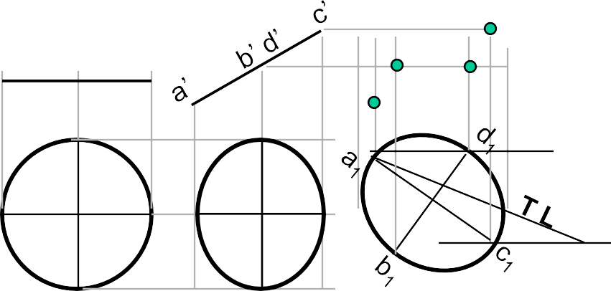
c’₁
Problem 8: A circle of 50 mm diameter is resting on Hp on end A of it’s diameter AC which is 30⁰ inclined to Hp while it’s Tv
is 45⁰ inclined to Vp.Draw it’s projections.
a’
b’ d’
c’
b’
1
30⁰
a’
d’
1
Y
X
45⁰
1
d
d₁
a
c_{a1}
c₁
Read problem and answer following questions
Surface inclined to which plane? ------- HP
Assumption for initial position? ------ // to HP
So which view will show True shape? --- TV
Which diameter horizontal? ---------- AC Hence begin with TV,draw rhombus below X-Y line, taking longer diagonal // to X-Y
b b₁
The difference in these two problems is in step 3 only.
In problem no.8 inclination of Tv of that AC is given,It could be drawn directly as shown in 3rd step.
While in no.9 angle of AC itself i.e. it’s TL, is given. Hence here angle of TL is taken,locus of c₁ Is drawn and then LTV I.e. a₁ c₁ is marked and
final TV was completed.Study illustration carefully.
Problem 9: A circle of 50 mm diameter is resting on Hp on end A of it’s diameter AC which is 30⁰ inclined to Hp while it makes 45⁰ inclined to Vp. Draw it’s projections.
c’₁
a’
c’
b’₁
a’₁
b’ d’
d’₁
d
d₁
Note the difference in construction of 3rd step in both solutions.
30⁰
a
c
a₁
c
1
b
b₁

Slide 63

Read problem and answer following questions
Surface inclined to which plane? ------- HP
Assumption for initial position? ------ // to HP
So which view will show True shape? --- TV
Which diameter horizontal? ---------- AB Hence begin with TV,draw CIRCLE below X-Y line, taking DIA. AB // to X-Y
Problem 10: End A of diameter AB of a circle is in HP A nd end B is in VP.Diameter AB, 50 mm long is 30⁰ & 60⁰ inclined to HP & VP respectively.
Draw projections of circle.
The problem is similar to previous problem of circle – no.9. But in the 3rd step there is one more change.
Like 9th problem True Length inclination of dia.AB is definitely expected
but if you carefully note - the the SUM of it‟s inclinations with HP & VP is 90⁰. Means Line AB lies in a Profile Plane.
Hence it‟s both Tv & Fv must arrive on one single projector.
So do the construction accordingly AND note the case carefully..
X
30⁰
Y
60⁰
SOLVE SEPARATELY ON DRAWING SHEET
GIVING NAMES TO VARIOUS
POINTS AS USUAL,
AS THE CASE IS IMPORTANT

Slide 64


Read problem and answer following questions
Problem 11:
A hexagonal lamina has its one side in HP and Its apposite parallel side is 25mm above Hp and In Vp. Draw it’s projections.
Take side of hexagon 30 mm long.
Surface inclined to which plane? ------- HP
Assumption for initial position? ------ // to HP
So which view will show True shape? --- TV
Which diameter horizontal? ---------- AC Hence begin with TV,draw rhombus below X-Y line, taking longer diagonal // to X-Y
ONLY CHANGE is the manner in which surface inclination
is described:
One side on Hp & it’s opposite side 25 mm above Hp. Hence redraw 1st Fv as a 2nd Fv making above arrangement. Keep a’b’ on xy & d’e’ 25 mm above xy.
e’₁
d’₁
25
f’₁
_{c} ’
X
a’b’
c’ f’
1
Y
d’e’
a’ b’
1
e₁ d₁
f
f₁
1
a
e
f₁
c₁
a
1
e
1
a₁
b₁
As 3rd step redraw 2nd Tv keeping
b
d
b₁
d₁
c
c₁
side DE on xy line. Because it is in VP as said in problem.

Slide 65
FREELY SUSPENDED CASES.
IMPORTANT POINTS
Problem 12:
An isosceles triangle of 40 mm long base side, 60 mm long altitude Is freely suspended from one corner of Base side.It‟s plane is 45⁰ inclined to Vp. Draw it‟s projections.
In this case the plane of the figure always remains perpendicular to Hp.
It may remain parallel or inclined to Vp.
Hence TV in this case will be always a LINE view.
Assuming surface // to Vp, draw true shape in suspended position as FV. (Here keep line joining point of contact & centroid of fig. vertical ) 5.Always begin with FV as a True Shape but in a suspended position.
AS shown in 1st FV.
a’₁
a’
C
b’
g‟
b’₁
g’
1
H
G
c’
c’₁
H/3
X
Y
A
B
b
a,g
c
45⁰
First draw a given triangle With given dimensions, Locate it‟s centroid position And
join it with point of suspension.
Similarly solve next problem of Semi-circle

Slide 66
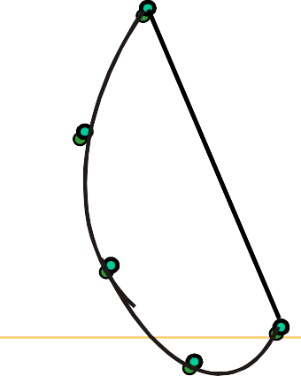
IMPORTANT POINTS
Problem 13
:A semicircle of 100 mm diameter is suspended from a point on its
straight edge 30 mm from the midpoint of that edge so that the surface makes an angle of 45⁰ with VP.
Draw its projections.
In this case the plane of the figure always remains perpendicular to Hp.
It may remain parallel or inclined to Vp.
Hence TV in this case will be always a LINE view.
Assuming surface // to Vp, draw true shape in suspended position as FV. (Here keep line joining point of contact & centroid of fig. vertical ) 5.Always begin with FV as a True Shape but in a suspended position.
AS shown in 1st FV.
A
a’
20 mm
p’
P
G
CG
b’
g’
c’
e’
X
d’
Y
First draw a given semicircle With given diameter,
Locate it‟s centroid position And
join it with point of suspension.
b c a p,g d
e

Slide 67
SOLIDS
To understand and remember various solids in this subject properly, those are classified & arranged in to two major groups.
Group A Group B
Solids having top and base of same shape Solids having base of some shape
and just a point as a top, called apex.
Cylinder
Cone
Prisms
Pyramids
Triangular Square Pentagonal
Hexagonal
Triangular Square Pentagonal
Tetrahedron
( A solid having Four triangular faces)
Hexagonal
Cube
( A solid having
six square faces)

Slide 68







SOLIDS
Dimensional parameters of different solids.
Square Prism Square Pyramid
Cylinder
Cone
Apex
Apex
Top
Rectangular Face Longer Edge
Slant Edge
Triangular Face
Base
Base
Base
Base
Corner of base
Edge of Base
Edge of Base
Corner of base
Generators
Imaginary lines generating curved surface of cylinder & cone.
Sections of solids( top & base not parallel)
Frustum of cone & pyramids.
( top & base parallel to each other)

Slide 69
STANDING ON H.P
On it’s base.
(Axis perpendicular to Hp And // to Vp.)
F.V. F.V.
RESTING ON H.P
On one point of base circle.
(Axis inclined to Hp And // to Vp)
LYING ON H.P
On one generator.
(Axis inclined to Hp And // to Vp)
F.V.
X
While observing Fv, x-y line represents Horizontal Plane. (Hp)
Y
X
While observing Tv, x-y line represents Vertical Plane. (Vp)
Y
T.V.
T.V.
T.V.
STANDING ON V.P
On it’s base.
Axis perpendicular to Vp And // to Hp
RESTING ON V.P
On one point of base circle.
Axis inclined to Vp And // to Hp
LYING ON V.P
On one generator.
Axis inclined to Vp And // to Hp

Slide 70
STEPS TO SOLVE PROBLEMS IN SOLIDS
Problem is solved in three steps:
STEP 1: ASSUME SOLID STANDING ON THE PLANE WITH WHICH IT IS MAKING INCLINATION. ( IF IT IS INCLINED TO HP, ASSUME IT STANDING ON HP)
( IF IT IS INCLINED TO VP, ASSUME IT STANDING ON VP)
IF STANDING ON HP - IT’S TV WILL BE TRUE SHAPE OF IT’S BASE OR TOP: IF STANDING ON VP - IT’S FV WILL BE TRUE SHAPE OF IT’S BASE OR TOP. BEGIN WITH THIS VIEW:
IT’S OTHER VIEW WILL BE A RECTANGLE ( IF SOLID IS CYLINDER OR ONE OF THE PRISMS): IT’S OTHER VIEW WILL BE A TRIANGLE ( IF SOLID IS CONE OR ONE OF THE PYRAMIDS):
DRAW FV & TV OF THAT SOLID IN STANDING POSITION:
STEP 2: CONSIDERING SOLID’S INCLINATION ( AXIS POSITION ) DRAW IT’S FV & TV.
STEP 3: IN LAST STEP, CONSIDERING REMAINING INCLINATION, DRAW IT’S FINAL FV & TV.
GENERAL PATTERN ( THREE STEPS ) OF SOLUTION:
GROUP B SOLID. CONE
GROUP A SOLID. CYLINDER
AXIS AXIS VERTICAL INCLINED HP
GROUP B SOLID. CONE
AXIS
GROUP A SOLID.
CYLINDER
AXIS
INCLINED HP
INCLINED HP
AXIS AXIS VERTICAL INCLINED HP
er
er
AXIS TO VP _{INCLINED}
VP
AXIS INCLINED VP
AXIS
INCLINED VP
AXIS TO VP
AXIS INCLINED VP
AXIS
Three steps
If solid is inclined to Hp
Three steps
If solid is inclined to Hp
Three steps
If solid is inclined to Vp
Three steps
If solid is inclined to Vp
Study Next Twelve Problems and Practice them separately !!

Slide 71
CATEGORIES OF ILLUSTRATED PROBLEMS!
PROBLEM NO.1, 2, 3, 4 GENERAL CASES OF SOLIDS INCLINED TO HP & VP
PROBLEM NO. 5 & 6 CASES OF CUBE & TETRAHEDRON
PROBLEM NO. 7 | CASE | OF FREELY SUSPENDED SOLID WITH SIDE VIEW.
PROBLEM NO. 8 | CASE | OF CUBE ( WITH SIDE VIEW)
PROBLEM NO. 9 | CASE | OF TRUE LENGTH INCLINATION WITH HP & VP.
PROBLEM NO. 10 & 11 | CASES | OF COMPOSITE SOLIDS. (AUXILIARY PLANE)
PROBLEM NO. 12 | CASE | OF A FRUSTUM (AUXILIARY PLANE)

Slide 72

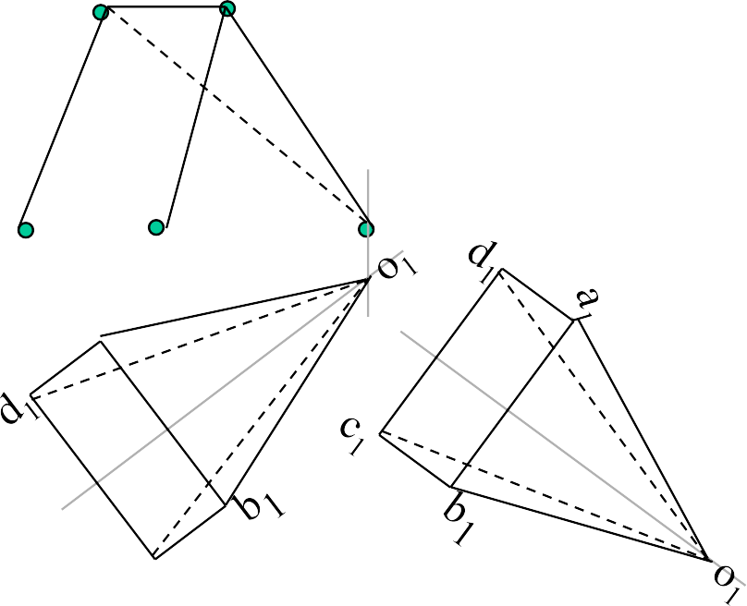


Problem 1.
Solution Steps :
A square pyramid, 40
Triangular face on Hp , means it is lying on Hp:
Assume it standing on Hp.
It’s Tv will show True Shape of base( square)
Draw square of 40mm sides with one side vertical Tv & taking 50 mm axis project Fv. ( a triangle)
Name all points as shown in illustration.
Draw 2nd Fv in lying position I.e.o’c’d’ face on xy. And project it’s Tv. 6.Make visible lines dark and hidden dotted, as per the procedure.
7.Then construct remaining inclination with Vp
( Vp containing axis ic the center line of 2nd Tv.Make it 45⁰ to xy as shown take apex near to xy, as it is nearer to Vp) & project final Fv.
mm base sides and axis 60 mm long, has a triangular face on the ground and the vertical plane containing the axis makes an angle of 45⁰ with the VP. Draw its projections. Take apex nearer to VP
o’
a’₁
b’₁
a’b’
Y
X
c’d’
d’₁
c’₁
o’₁
a
d
d₁
a₁
a₁
o
o₁
b
c
c₁
b₁
(APEX
NEARER TO V.P).
(APEX AWAY
FROM V.P.)
For dark and dotted lines
1.Draw proper outline of new view DARK. 2. Decide direction of an observer.
Select nearest point to observer and draw all lines starting from it-dark.
Select farthest point to observer and draw all lines (remaining)from it- dotted.

Slide 73
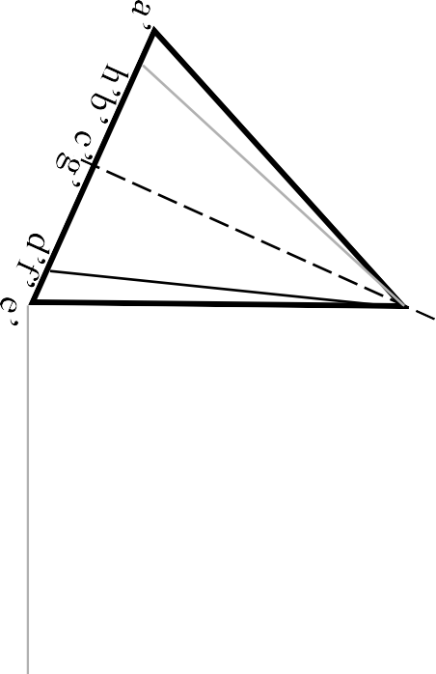
Problem 2:
A cone 40 mm diameter and 50 mm axis
is resting on one generator on Hp which makes 30⁰ inclination with Vp Draw it’s projections.
Solution Steps:
Resting on Hp on one generator, means lying on Hp: 1.Assume it standing on Hp.
It’s Tv will show True Shape of base( circle )
Draw 40mm dia. Circle as Tv &
taking 50 mm axis project Fv. ( a triangle) 4.Name all points as shown in illustration.
Draw 2nd Fv in lying position I.e.o’e’ on xy. And project it’s Tv below xy.
Make visible lines dark and hidden dotted, as per the procedure.
Then construct remaining inclination with Vp
( generator o₁e₁ 30⁰ to xy as shown) & project final Fv.
For dark and dotted lines
Draw proper outline of new vie DARK.
Decide direction of an observer.
Select nearest point to observer and draw all lines starting from it-dark.
Select farthest point to observer and draw all lines (remaining) from it- dotted.
o’
a’₁
h’
1
b’₁
g’₁
X
o’
f’₁
c’
1
Y
o₁
30
a’ h’b’ c’ g
f’ d’ e’
e’₁
d’
1
’
g₁
g
o
g₁
h
1
h
f
f₁
h₁
1
f₁
a₁
a
e e₁
a₁
o₁
e₁
b₁
b
d
d₁
b₁
d
1
c₁
c
c
1

Slide 74
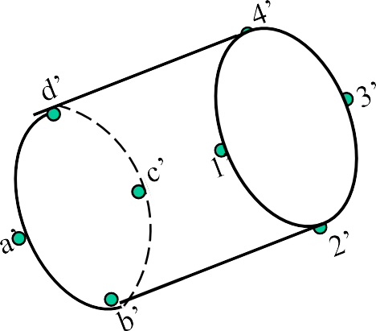
Problem 3:
A cylinder 40 mm diameter and 50 mm
axis is resting on one point of a base
circle on Vp while it’s axis makes 45⁰
Solution Steps:
Resting on Vp on one point of base, means inclined to Vp: 1.Assume it standing on Vp
It’s Fv will show True Shape of base & top( circle )
Draw 40mm dia. Circle as Fv & taking 50 mm axis project Tv. ( a Rectangle)
_{with Vp and Fv of the axis 35}0 _{with Hp.} 4.Name all points as shown in illustration.
Draw projections..
5.Draw 2nd Tv making axis 45⁰ to xy And project it’s Fv above xy. 6.Make visible lines dark and hidden dotted, as per the procedure. 7.Then construct remaining inclination with Hp
( Fv of axis I.e. center line of view to xy as shown) & project final Tv.
4’d’
d’
4’
3’
c’
1’a’
c’ a’
1’
3’
X
2’ b’
b d
b’
2’
35⁰
Y
a
c
45⁰
c₁
d₁
b
1
a₁
3
4
1
2 4
3
2
1

Slide 75

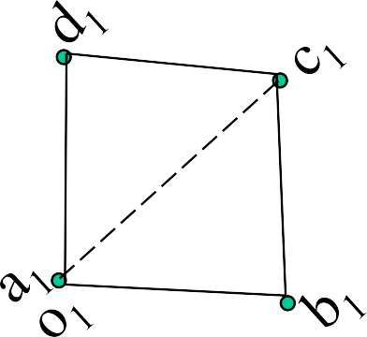
Solution Steps :
1.Assume it standing on Hp but as said on apex.( inverted ). 2.It’s Tv will show True Shape of base( square)
3.Draw a corner case square of 30 mm sides as Tv(as shown) Showing all slant edges dotted, as those will not be visible from top. 4.taking 50 mm axis project Fv. ( a triangle)
Name all points as shown in illustration.
Draw 2nd Fv keeping o’a’ slant edge vertical & project it’s Tv 7.Make visible lines dark and hidden dotted, as per the procedure. 8.Then redrew 2nd Tv as final Tv keeping a₁o₁d₁ triangular face
perpendicular to Vp I.e.xy. Then as usual project final Fv.
Problem 4:A square pyramid 30 mm base side
and 50 mm long axis is resting on it’s apex on Hp, such that it’s one slant edge is vertical and a triangular face through it is perpendicular to Vp.
Draw it’s projections.
a’
b’d’ c’
a’₁
d’₁
b’₁
c’₁
X
o’
o’₁
Y
d
d₁
_{c} a₁
a
b_{o}
o₁
b₁ c₁

Slide 76


Solution Steps:
Problem 5: A cube of 50 mm long edges is so placed on Hp on one corner that a body diagonal is parallel to Hp and perpendicular to Vp Draw it’s projections.
1.Assuming standing on Hp, begin with Tv,a square with all sides equally inclined to xy.Project Fv and name all points of FV & TV. 2.Draw a body-diagonal joining c’ with 3’( This can become // to xy) 3.From 1’ drop a perpendicular on this and name it p’
4.Draw 2nd Fv in which 1’-p’ line is vertical means c’-3’ diagonal must be horizontal. .Now as usual project Tv..
6.In final Tv draw same diagonal is perpendicular to Vp as said in problem. Then as usual project final FV.
a’₁
d’₁
d’
a’
b’d’
c’
1
3’
c’₁
X
3’
1’
1’
1’
Y
d
d₁
a
c
a₁
c₁
b
b₁

Slide 77
Problem 6:A tetrahedron of 50 mm long edges is resting on one edge on
Solution Steps
As it is resting assume it standing on Hp.
Hp while one triangular face containing
Begin with Tv , an equilateral triangle as side case as shown: First project base points of Fv on xy, name those & axis line. From a’ with TL of edge, 50 mm, cut on axis line & mark o’ (as axis is not known, o’ is finalized by slant edge length) Then complete Fv.
In 2nd Fv make face o’b’c’ vertical as said in problem. And like all previous problems solve completely.
this edge is vertical and 45⁰ inclined to Vp. Draw projections.
IMPORTANT:
Tetrahedron is a special type
of triangular pyramid in which base sides & slant edges are equal in length.
Solid of four faces. Like cube it is also described by One dimension only..
Axis length generally not given.
o’₁
o’
T L
a’₁
90⁰
X
a’
b’
b’₁
c’
c’
1
Y
45⁰
c
c₁
a
o
a₁
o₁
b
b₁

Slide 78














ENGINEERING APPLICATIONS OF
THE PRINCIPLES OF
PROJECTIONS OF SOLIDES.
SECTIONS OF SOLIDS.
DEVELOPMENT.
INTERSECTIONS.
STUDY CAREFULLY
THE ILLUSTRATIONS GIVEN ON NEXT SIX PAGES !

Slide 79

























SECTIONING A SOLID.
An object ( here a solid ) is cut by some imaginary cutting plane
The action of cutting is called SECTIONING a solid
&
The plane of cutting is called
SECTION PLANE.
to understand internal details of that object.
Two cutting actions means section planes are recommended.
OBSERVER
A) Section Plane perpendicular to Vp and inclined to Hp.
( This is a definition of an Aux. Inclined Plane i.e. A.I.P.)
NOTE:- This section plane appears as a straight line in FV.
ASSUME UPPER PART REMOVED
(A)
B) Section Plane perpendicular to Hp and inclined to Vp.
( This is a definition of an Aux. Vertical Plane i.e. A.V.P.)
NOTE:- This section plane appears
as a straight line in TV.
Remember:-
After launching a section plane
either in FV or TV, the part towards observer is assumed to be removed.
As far as possible the smaller part is
assumed to be removed.
(B)
ASSUME LOWER PART REMOVED
OBSERVER

Slide 80




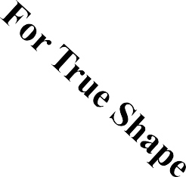













ILLUSTRATION SHOWING IMPORTANT TERMS
IN SECTIONING.
For TV
SECTION PLANE
TRUE SHAPE
Of SECTION
x
Apparent Shape of section
y
SECTION LINES (45⁰ to XY)
SECTIONAL T.V.

Slide 81



























Typical Section Planes
&
Typical Shapes Of
Sections.
Section Plane Through Generators
Ellipse
Section Plane^{Triangle}
Through Apex
Section Plane Parallel to end generator.
Section Plane
Hyperbola
Parallel to Axis.
Ellipse
Trapezium
Cylinder through generators.
Sq. Pyramid through all slant edges

Slide 82














DEVELOPMENT OF SURFACES OF SOLIDS.
MEANING:-
ASSUME OBJECT HOLLOW AND MADE-UP OF THIN SHEET. CUT OPEN IT FROM ONE SIDE AND UNFOLD THE SHEET COMPLETELY. THEN THE SHAPE OF THAT UNFOLDED SHEET IS CALLED DEVELOPMENT OF LATERLAL SUEFACES OF THAT OBJECT OR SOLID.
LATERLAL SURFACE IS THE SURFACE EXCLUDING SOLID’S TOP & BASE.
ENGINEERING APLICATION:
THERE ARE SO MANY PRODUCTS OR OBJECTS WHICH ARE DIFFICULT TO MANUFACTURE BY CONVENTIONAL MANUFACTURING PROCESSES, BECAUSE OF THEIR SHAPES AND SIZES. THOSE ARE FABRICATED IN SHEET METAL INDUSTRY BY USING
DEVELOPMENT TECHNIQUE. THERE IS A VAST RANGE OF SUCH OBJECTS.
EXAMPLES:-
Boiler Shells & chimneys, Pressure Vessels, Shovels, Trays, Boxes & Cartons, Feeding Hoppers,
Large Pipe sections, Body & Parts of automotives, Ships, Aeroplanes and many more.
WHAT IS
OUR OBJECTIVE IN THIS TOPIC ?
To learn methods of development of surfaces of different solids, their sections and frustums.
But before going ahead, note following Important points.
Development is different drawing than PROJECTIONS.
It is a shape showing AREA, means it’s a 2-D plain drawing.
Hence all dimensions of it must be TRUE dimensions.
As it is representing shape of an un-folded sheet, no edges can remain hidden And hence DOTTED LINES are never shown on development.
Study illustrations given on next page carefully.

Slide 83

Development of lateral surfaces of different solids. (Lateral surface is the surface excluding top & base)
Cylinder:
A Rectangle
Pyramids: (No.of triangles)
Cone: (Sector of circle)
H
πD
θ
R=Base circle radius.
L=Slant height.
D
H= Height D= base diameter
Prisms:
No.of Rectangles
L= Slant edge.
S = Edge of base
_{θ =} R
L
360⁰
H
S
S
H= Height
S = Edge of base
Cube: Six Squares.
Tetrahedron: Four Equilateral Triangles
All sides equal in length

Slide 84






FRUSTUMS
DEVELOPMENT OF
FRUSTUM OF CONE
DEVELOPMENT OF
FRUSTUM OF SQUARE PYRAMID
Base side
Top side
θ
_{θ =} R
L
360⁰
R= Base circle radius of cone L= Slant height of cone
L₁ = Slant height of cut part.
L= Slant edge of pyramid L₁ = Slant edge of cut part.
STUDY NEXT NINE PROBLEMS OF SECTIONS & DEVELOPMENT

Slide 85

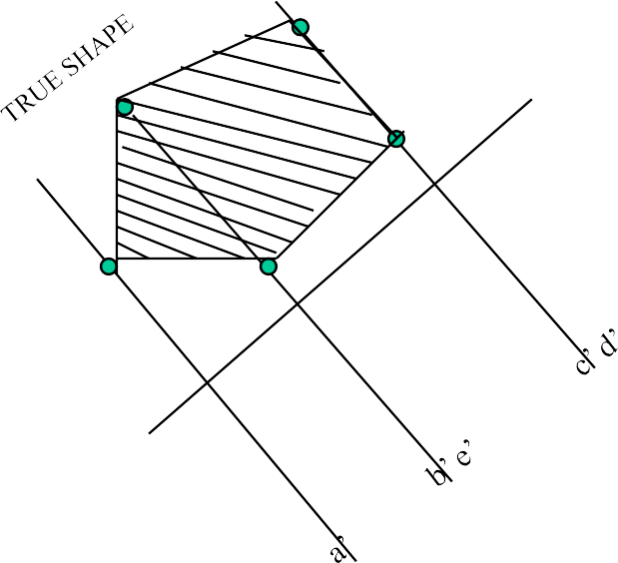



















Problem 1: A pentagonal prism , 30 mm base side & 50 mm axis
is standing on Hp on it’s base whose one side is perpendicular to Vp. It is cut by a section plane 45⁰ inclined to Hp, through mid point of axis. Draw Fv, sec.Tv & sec. Side view. Also draw true shape of section and Development of surface of remaining solid.
C
Solution Steps:for sectional views: Draw three views of standing prism. Locate sec.plane in Fv as described. Project points where edges are getting Cut on Tv & Sv as shown in illustration. Join those points in sequence and show Section lines in it.
Make remaining part of solid dark.
B
D
Y
1
A
E
A
B
C
D
E
A
d”
c”
X₁
e”
b”
X
a”
Y
e
DEVELOPMENT
d
For True Shape:
a
For Development:
Draw development of entire solid. Name from cut-open edge I.e. A. in sequence as shown. Mark the cut points on respective edges.
Draw x₁y₁ // to sec. plane Draw projectors on it from
c
cut points.
b
Mark distances of points of Sectioned part from Tv, on above projectors from
Join them in sequence in st. lines. Make existing parts dev.dark.
x₁y₁ and join in sequence. Draw section lines in it.
It is required true shape.

Slide 86






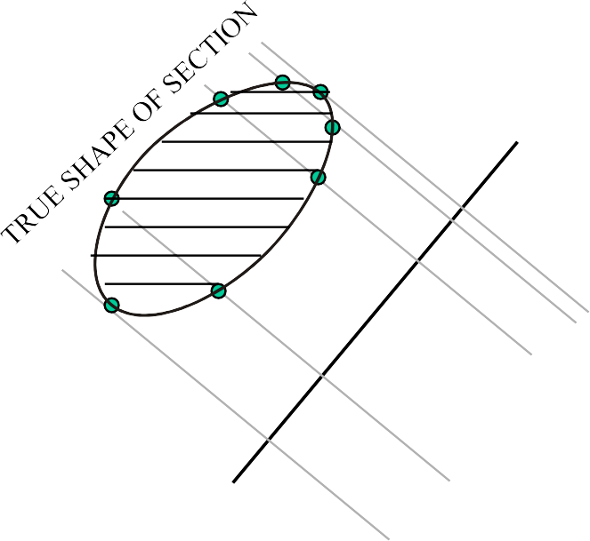























Problem 2: A cone, 50 mm base diameter and 70 mm axis is standing on it’s base on Hp. It cut by a section plane 45⁰ inclined to Hp through base end of end generator.Draw projections,
sectional views, true shape of section and development of surfaces
of remaining solid.
Solution Steps:for sectional views: Draw three views of standing cone. Locate sec.plane in Fv as described. Project points where generators are getting Cut on Tv & Sv as shown in illustration.Join those points in sequence and show Section lines in it. Make remaining part of solid dark.
Y₁
SECTIONAL S.V
A
o’
B
DEVELOPMENT
C
D
X₁
E
X
a’ h’b
’ c’ g’
f’ d’ e’
g” h”f”
a”e”
b”d” c”
Y
F
g
For True Shape:
Draw x₁y₁ // to sec. plane Draw projectors on it from cut points.
Mark distances of points of Sectioned part from Tv, on above projectors from
h
f
G
a
e
For Development:
Draw development of entire solid. Name from cut-open edge i.e. A.
in sequence as shown.Mark the cut
points on respective edges.
Join them in sequence in curvature. Make existing parts dev.dark.
H
A
b
d
x₁y₁ and join in sequence.
c
SECTIONAL T.V
Draw section lines in it. It is required true shape.

Slide 87



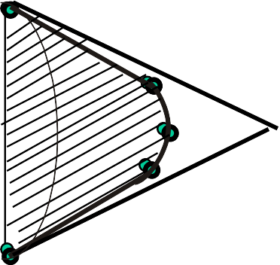
Problem 3: A cone 40mm diameter and 50 mm axis is resting on one generator on Hp( lying on Hp) which is // to Vp.. Draw it‟s projections.It is cut by a horizontal section plane through it‟s base center. Draw sectional TV, development of the surface of the remaining part of cone.
Follow similar solution steps for Sec.views - True shape – Development as per previous problem!
o’
DEVELOPMENT
A
B
HORIZONTAL SECTION PLANE
C
D
X
a’ h’b’
c’ g’
f’ d’ e’
o’
Y
g
g₁
O
E
h
f
f₁
h₁
F
a
O
e e₁
a₁
o₁
G
H
b
d
d₁
b₁
c
A
c
1
SECTIONAL T.V
(SHOWING TRUE SHAPE OF SECTION)

Slide 88




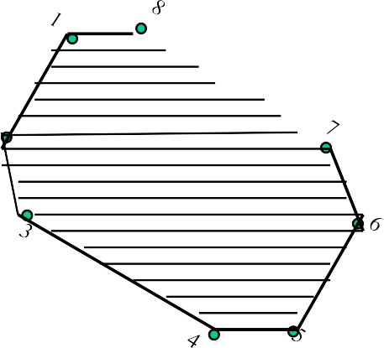
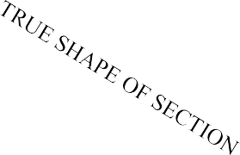
Note the steps to locate Points 1, 2 , 5, 6 in sec.Fv: Those are transferred to 1st TV, then to 1st Fv and Then on 2nd Fv.
Problem 4: A hexagonal prism. 30 mm base side & 55 mm axis is lying on Hp on it’s rect.face with axis
// to Vp. It is cut by a section plane normal to Hp and
30⁰ inclined to Vp bisecting axis.
Draw sec. Views, true shape & development.
a’ b’
c’ f’
d’ e’
3
SECTIONAL F.V.
Use similar steps for sec.views & true shape. NOTE: for development, always cut open object from From an edge in the boundary of the view in which sec.plane appears as a line.
Here it is Tv and in boundary, there is c1 edge.Hence it is opened from c and named C,D,E,F,A,B,C.
4
2
5
X
1
6
Y
f
8
7
f₁
a
e
a₁ e₁
A.V.P30⁰ inclined to Vp Through mid-point of axis.
b
d
b₁ d₁
AS SECTION PLANE IS IN T.V.,
CUT OPEN FROM BOUNDRY EDGE C₁ FOR DEVELOPMENT.
c
X₁
c₁
C
D
E F A
B
C
Y₁
DEVELOPMENT

Slide 89








Problem 5:A solid composed of a half-cone and half- hexagonal pyramid is shown in figure.It is cut by a section plane 45⁰ inclined to Hp, passing through mid-point of axis.Draw F.v., sectional T.v.,true shape of section and development of remaining part of the solid.
( take radius of cone and each side of hexagon 30mm long and axis 70mm.)
2
3
4
5
Y₁
O’
1
6
Note:
Fv & TV 8f two solids sandwiched
Section lines style in both:
Development of
half cone & half pyramid:
A
7
B
4’
3’
C
X₁
5’
F.V.
2’
6’
4
3
2
1’
1
D
7’
X
Y
d’e’
c’f’ f
g’b’ a’
O
E
6
g
7
e
5
SECTIONAL ⁷
4
4
5
6
TOP VIEW.
a
F
1
3
d
2
b
G
c
A

Slide 90
INTERPENETRATION OF SOLIDS
WHEN ONE SOLID PENETRATES ANOTHER SOLID THEN THEIR SURFACES INTERSECT AND
AT THE JUNCTION OF INTERSECTION A TYPICAL CURVE IS FORMED, WHICH REMAINS COMMON TO BOTH SOLIDS.
THIS CURVE IS CALLED CURVE OF INTERSECTION AND
IT IS A RESULT OF INTERPENETRATION OF SOLIDS.
PURPOSE OF DRAWING THESE CURVES:-
WHEN TWO OBJECTS ARE TO BE JOINED TOGATHER, MAXIMUM SURFACE CONTACT BETWEEN BOTH BECOMES A BASIC REQUIREMENT FOR STRONGEST & LEAK-PROOF JOINT.
Curves of Intersections being common to both Intersecting solids, show exact & maximum surface contact of both solids.
Study Following Illustrations Carefully.
Minimum Surface Contact.
( Point Contact)
(Maximum Surface Contact)
Lines of Intersections. Curves of Intersections.
Square Pipes.
Circular Pipes.
Square Pipes.
Circular Pipes.

Slide 91
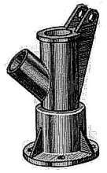
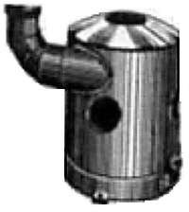
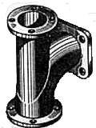
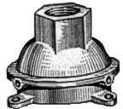
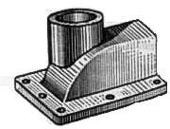
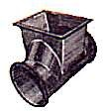
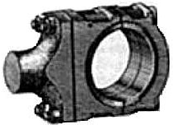
SOME ACTUAL OBJECTS ARE SHOWN, SHOWING CURVES OF INTERSECTIONS. BY WHITE ARROWS.
A machine component having two intersecting cylindrical surfaces with the axis at acute angle to each other.
An Industrial Dust collector.
Intersection of two cylinders.
Intersection of a Cylindrical main and Branch Pipe.
Pump lid having shape of a
hexagonal Prism and Hemi-sphere intersecting each other.
A Feeding Hopper In industry.
Forged End of a Connecting Rod.
Two Cylindrical surfaces.

Slide 92
COMMON SOLUTION STEPS
FOLLOWING CASES ARE SOLVED. REFFER ILLUSTRATIONS
AND
NOTE THE COMMON CONSTRUCTION FOR ALL
One solid will be standing on HP Other will penetrate horizontally. Draw three views of standing solid. Name views as per the illustrations. Beginning with side view draw three Views of penetrating solids also.
On it’s S.V. mark number of points And name those(either letters or nos.) The points which are on standard generators or edges of standing solid, ( in S.V.) can be marked on respective generators in Fv and Tv. And other points from SV should be brought to Tv first and then projecting upward To Fv.
Dark and dotted line’s decision should be taken by observing side view from it’s right side as shown by arrow.
Accordingly those should be joined by curvature or straight lines.
1.CYLINDER TO CYLINDER2.
2.SQ.PRISM TO CYLINDER
3.CONE TO CYLINDER
4.TRIANGULAR PRISM TO CYLNDER
5.SQ.PRISM TO SQ.PRISM
SQ.PRISM TO SQ.PRISM ( SKEW POSITION)
SQARE PRISM TO CONE ( from top )
8.CYLINDER TO CONE
Note:
Incase cone is penetrating solid Side view is not necessary. Similarly in case of penetration from top it is not required.

Slide 93
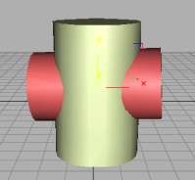
Problem: A cylinder 50mm dia.and 70mm axis is completely penetrated by another of 40 mm dia.and 70 mm axis horizontally Both axes intersect & bisect each other. Draw projections showing curves of intersections.
CASE 1.
CYLINDER STANDING
&
CYLINDER PENETRATING
2”
1’
2’ 4’
3’
4”
1”3”
a’
a”
b ’h’
h”
b”
c’g’
g”
c”
d’f’
f”
d”
a’
e”
X
Y
4
1
3
2

Slide 94
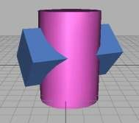
Problem: A cylinder 50mm dia.and 70mm axis is completely penetrated by a square prism of 25 mm sides.and 70 mm axis, horizontally. Both axes Intersect & bisect each other. All faces of prism are equally inclined to Hp. Draw projections showing curves of intersections.
CASE 2.
CYLINDER STANDING
&
SQ.PRISM PENETRATING
2”
1’
2’ 4’ 3’ 4”
a’
1”3”
a’
a”
b’
b’
d”
b”
d’
d’
c’
c’
c”
X
Y
4
1
3
2

Slide 95
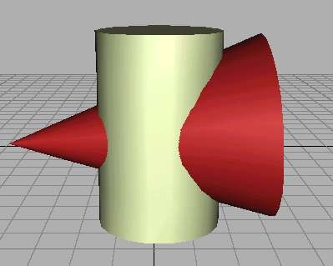

CASE 3.
Problem: A cylinder of 80 mm diameter and 100 mm axis is completely penetrated by a cone of 80 mm diameter and 120 mm long axis horizontally.Both axes intersect & bisect each other. Draw projections showing curve of intersections.
CYLINDER STANDING
&
CONE PENETRATING
7’
6’ 8’
1’ 5’
2’ 4’
3’
X
Y
1
2 8
3 7
4 6
5

Slide 96
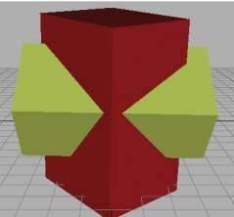
Problem: A sq.prism 30 mm base sides.and 70mm axis is completely penetrated
CASE 4.
by another square prism of 25 mm sides.and 70 mm axis, horizontally. Both axesSQ.PRISM STANDING
Intersects & bisect each other. All faces of prisms are equally inclined to Vp. Draw projections showing curves of intersections.
&
SQ.PRISM PENETRATING
1’
2’4’
3’
4”
1”3”
2”
a’
a’
a”
b’
b’
d”
b”
d’
d’
c’
c’
c”
X
Y
4
1
3
2

Slide 97
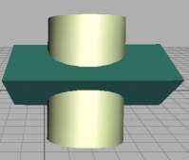
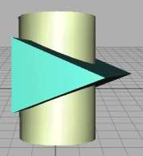
Problem: A cylinder 50mm dia.and 70mm axis is completely penetrated
by a triangular prism of 45 mm sides.and 70 mm axis, horizontally. One flat face of prism is parallel to Vp and Contains axis of cylinder. Draw projections showing curves of intersections.
CASE 5. CYLINDER STANDING & TRIANGULAR PRISM PENETRATING
1’
2’4’ 3’ 4”
a
1”3” 2”
a
a
b
b
b
c
c
d
e
e
d
e
f
f
f
X
Y
4
1
3
2

Slide 98
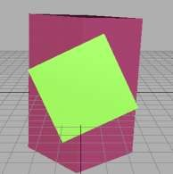
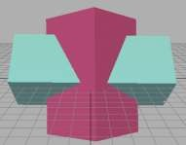
CASE 6.
Problem: A sq.prism 30 mm base sides.and 70mm axis is completely penetrated by another square prism of 25 mm side s.and 70 mm axis, horizontally. Both axes Intersect & bisect each other.Two faces of penetrating prism are 30⁰ inclined to Hp. Draw projections showing curves of intersections.
SQ.PRISM STANDING
&
SQ.PRISM PENETRATING (30⁰ SKEW POSITION)
1”3” 2”
1’
2’4’ 3’
4”
a’
f”
f’
e’
b’
c’
c”
d’
X
30⁰
Y
4
1
3
2

Slide 99






ISOMETRIC DRAWING
TYPICAL CONDITION.
IT IS A TYPE OF PICTORIAL PROJECTION IN WHICH ALL THREE DIMENSIONS OF
AN OBJECT ARE SHOWN IN ONE VIEW AND IF REQUIRED, THEIR ACTUAL SIZES CAN BE MEASURED DIRECTLY FROM IT.
IN THIS 3-D DRAWING OF AN OBJECT, ALL THREE DIMENSIONAL AXES ARE MENTAINED AT EQUAL INCLINATIONS WITH EACH OTHER.( 120⁰)
3-D DRAWINGS CAN BE DRAWN
IN NUMEROUS WAYS AS SHOWN BELOW. ALL THESE DRAWINGS MAY BE CALLED
3-DIMENSIONAL DRAWINGS, OR PHOTOGRAPHIC
OR PICTORIAL DRAWINGS. HERE NO SPECIFIC RELATION
AMONG H, L & D AXES IS MENTAINED.
NOW OBSERVE BELOW GIVEN DRAWINGS. ONE CAN NOTE SPECIFIC INCLINATION AMONG H, L & D AXES.
ISO MEANS SAME, SIMILAR OR EQUAL. HERE ONE CAN FIND
EDUAL INCLINATION AMONG H, L & D AXES. EACH IS 120⁰ INCLINED WITH OTHER TWO. HENCE IT IS CALLED ISOMETRIC DRAWING
L
H
H
H
PURPOSE OF ISOMETRIC DRAWING IS TO UNDERSTAND
OVERALL SHAPE, SIZE & APPEARANCE OF AN OBJECT PRIOR TO IT‟S PRODUCTION.

Slide 100

SOME IMPORTANT TERMS:
ISOMETRIC AXES, LINES AND PLANES:
The three lines AL, AD and AH, meeting at point A and making 120⁰ angles with each other are termed Isometric Axes.
The lines parallel to these axes are called Isometric Lines.
A
The planes representing the faces of of the cube as well as other planes parallel to these planes are called Isometric Planes.
H
ISOMETRIC SCALE:
When one holds the object in such a way that all three dimensions
are visible then in the process all dimensions become proportionally
inclined to observer‟s eye sight and hence appear apparent in lengths.
This reduction is 0.815 or 9 / 11 ( approx.) It forms a reducing scale which Is used to draw isometric drawings and is called Isometric scale.
In practice, while drawing isometric projection, it is necessary to convert true lengths into isometric lengths for measuring and marking the sizes. This is conveniently done by constructing an isometric scale as described on next page.

Slide 101




TYPES OF ISOMETRIC DRAWINGS
ISOMETRIC VIEW
Drawn by using True scale ( True dimensions )
ISOMETRIC PROJECTION
Drawn by using Isometric scale
( Reduced dimensions )
D
4
3
H
H
2
C
4
1
3
2
CONSTRUCTION OF ISOM.SCALE.
From point A, with line AB draw 30⁰ and 45⁰ inclined lines AC & AD resp on AD. Mark divisions of true length and from each division-point draw vertical lines upto AC line.
The divisions thus obtained on AC give lengths on isometric scale.
0
0 30⁰
1
45⁰
A
B
Isometric scale [ Line AC ] required for Isometric Projection

Slide 102
Isometric view if the Shape is
1
SHAPE
ISOMETRIC
F.V. or T.V.
D
OF PLANE FIGURES
H
RECTANGLE
D
A
D
A
AS THESE ALL ARE 2-D FIGURES
WE REQUIRE ONLY TWO ISOMETRIC AXES.
C
C
A
B
C
B
B
IF THE FIGURE IS FRONT VIEW, H & L AXES ARE REQUIRED.
B
H
TRIANGLE
3
B
1
B
1
3
IF THE FIGURE IS TOP VIEW, D & L AXES ARE REQUIRED.
A
A
3
1
2
A
2
2
Shapes containing Inclined lines should be enclosed in a rectangle as shown.
Then first draw isom. of that rectangle and then inscribe that shape as it is.
4
PENTAGON
E
H
E
1
4
1
D
4
E
D
A
D
A
1
3
3
A
C
C
2
B
3
B
B
C
2
2

Slide 103





STU_{Z}DY
2
ILLUSTRATIONS
DRAW ISOMETRIC VIEW OF A CIRCLE IF IT IS A TV OR FV.
FIRST ENCLOSE IT IN A SQUARE.
IT‟S ISOMETRIC IS A RHOMBUS WITH D & L AXES FOR TOP VIEW.
THEN USE H & L AXES FOR ISOMETRIC WHEN IT IS FRONT VIEW.
FOR CONSTRUCTION USE RHOMBUS METHOD SHOWN HERE. STUDY IT.
2
A
B
3
4
D
C
1

Slide 104


STU_{Z}DY
3
ILLUSTRATIONS
25 R
DRAW ISOMETRIC VIEW OF THE FIGURE SHOWN WITH DIMENTIONS (ON RIGHT SIDE) CONSIDERING IT FIRST AS F.V. AND THEN T.V.
50 MM
IF FRONT VIEW
100 MM
IF TOP VIEW

Slide 105
SHAPE
ISOMETRIC
OF PLANE FIGURES
4
IF F.V.
IF T.V.
HEXAGON
AS THESE ALL ARE 2-D FIGURES
WE REQUIRE ONLY TWO ISOMETRIC AXES.
IF THE FIGURE IS FRONT VIEW, H & L AXES ARE REQUIRED.
IF THE FIGURE IS TOP VIEW, D & L AXES ARE REQUIRED.
CIRCLE
For Isometric of Circle/Semicircle use Rhombus method. Construct Rhombus of sides equal to Diameter of circle always. ( Ref. topic ENGG. CURVES.)
SEMI CIRCLE
For Isometric of
Circle/Semicircle use Rhombus method.
Construct it of sides equal to diameter of circle always. ( Ref. Previous two pages.)

Slide 106
STUDY
5
ILLUSTR^{Z}ATIONS
ISOMETRIC VIEW OF PENTAGONAL PYRAMID STANDING ON H.P.
(Height is added from center of pentagon)
ISOMETRIC VIEW OF BASE OF PENTAGONAL PYRAMID STANDING ON H.P.
4
4
D
D
E
E
1
3
1
3
A
C
B
A
C
2
B
2

Slide 107
STUDY
6
ILLUSTR^{Z}ATIONS
ISOMETRIC VIEW OF PENTAGONALL PRISM LYING ON H.P.
4
H
E
1
D
A
3
C
2
B
ISOMETRIC VIEW OF HEXAGONAL PRISM STANDING ON H.P.

Slide 108
ILLUSTR^{Z}ATIONS
7
STUDY
CYLINDER STANDING ON H.P.
CYLINDER LYING ON H.P.

Slide 109
8
STUDY
ILLUSTR^{Z}ATIONS
HALF CYLINDER
STANDING ON H.P.
( ON IT’S SEMICIRCULAR BASE)
HALF CYLINDER
LYING ON H.P.
( with flat face // to H.P.)

Slide 110
9
STUDY
ISOMETRIC VIEW OF
A FRUSTOM OF SQUARE PYRAMID
STANDING ON H.P. ON IT’S LARGER BASE.
ILLUSTR^{Z}ATIONS
60
FV
X
Y
40 20
TV

Slide 111
STUDY ILLUSTRATION
10
PROJECTIONS OF FRUSTOM OF PENTAGONAL PYRAMID ARE GIVEN. DRAW IT‟S ISOMETRIC VIEW.
ISOMETRIC VIEW OF
FRUSTOM OF PENTAGONAL PYRAMID
60
SOLUTION STEPS:
FV
FIRST DRAW ISOMETRIC OF IT‟S BASE.
x
y
THEN DRAWSAME SHAPE AS TOP, 60 MM ABOVE THE BASE PENTAGON CENTER.
1
E
4
A
THEN REDUCE THE TOP TO 20 MM SIDES AND JOIN WITH
THE PROPER BASE CORNERS.
TV
40
20
D
B
2
3
C

Slide 112



ISOMETRIC VIEW OF
11
STUDY
A FRUSTOM OF CONE
STANDING ON H.P. ON IT’S LARGER BASE.
ILLUSTR^{Z}ATIONS
60
FV
X
Y
40 20
TV

Slide 113



STUDY
PROBLEM: A SQUARE PYRAMID OF 30 MM BASE SIDES AND 50 MM LONG AXIS, IS CENTRALLY PLACED ON THE TOP OF A
CUBE OF 50 MM LONG EDGES.DRAW ISOMETRIC VIEW OF THE PAIR.
12
ILLUSTR^{Z}ATIONS

Slide 114
STUDY
13
ILLUSTR^{Z}ATIONS
c
PROBLEM: A TRIANGULAR PYRAMID OF 30 MM BASE SIDES AND 50 MM LONG AXIS, IS CENTRALLY PLACED ON THE TOP OF A CUBE OF 50 MM LONG EDGES.
DRAW ISOMETRIC VIEW OF THE PAIR.
a
o
p
a
b
o c
p
b
SOLUTION HINTS.
TO DRAW ISOMETRIC OF A CUBE IS SIMPLE. DRAW IT AS USUAL.
BUT FOR PYRAMID AS IT’S BASE IS AN EQUILATERAL TRIANGLE, IT CAN NOT BE DRAWN DIRECTLY.SUPPORT OF IT’S TV IS REQUIRED.
SO DRAW TRIANGLE AS A TV, SEPARATELY AND NAME VARIOUS POINTS AS SHOWN. AFTER THIS PLACE IT ON THE TOP OF CUBE AS SHOWN.
THEN ADD HEIGHT FROM IT’S CENTER AND COMPLETE IT’S ISOMETRIC AS SHOWN.

Slide 115
STUDY
14
PROBLEM:
A SQUARE PLATE IS PIERCED THROUGH CENTRALLY
BY A CYLINDER WHICH COMES OUT EQUALLY FROM BOTH FACES
OF PLATE. IT‟S FV & TV ARE SHOWN. DRAW ISOMETRIC VIEW.
ILLUSTR^{Z}ATIONS
FV
30
10
30
30 D
50
+
50
TV

Slide 116

STUDY
15
ILLUSTR^{Z}ATIONS
PROBLEM:
A CIRCULAR PLATE IS PIERCED THROUGH CENTRALLY
BY A SQUARE PYRAMID WHICH COMES OUT EQUALLY FROM BOTH FACES OF PLATE. IT‟S FV & TV ARE SHOWN. DRAW ISOMETRIC VIEW.
FV
30
10
30
40 SQUARE
TV
60 D

Slide 117

STUDY
16
ILLUSTR^{Z}ATIONS
F.V. & T.V. of an object are given. Draw it‟s isometric view.
10
20
40
FV
40
X
Y
TV
50 D
30 D

Slide 118

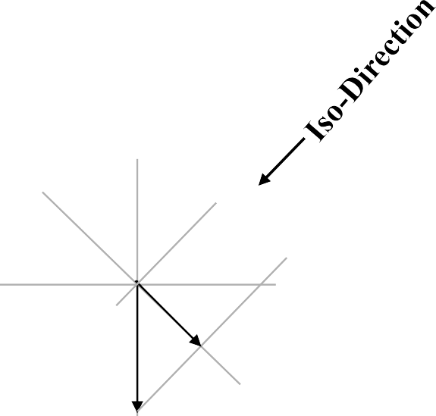
ILLUSTZRATIONS ISOMETRIC PROJECTIONS OF SPHERE & HEMISPHERE
STUDY
17
45⁰
r
30⁰
R
r
r
Isom. Scale
P
C
r
r
R
R
C
R
TO DRAW ISOMETRIC PROJECTION OF A HEMISPHERE
P
r
P
Adopt same procedure.
Draw lower semicircle only. Then around „C‟ construct Rhombus of Sides equal to Isometric Diameter.
For this use iso-scale. Then construct ellipse in this Rhombus as usual And Complete
Isometric-Projection of Hemi-sphere.
C = Center of Sphere. P = Point of contact
R = True Radius of Sphere r = Isometric Radius.
TO DRAW ISOMETRIC PROJECTION OF A SPHERE
FIRST DRAW ISOMETRIC OF SQUARE PLATE.
LOCATE IT‟S CENTER. NAME IT P.
FROM PDRAW VERTICAL LINE UPWARD, LENGTH „ r mm‟ AND LOCATE CENTER OF SPHERE “C”
„C‟ AS CENTER, WITH RADIUS „R‟ DRAW CIRCLE.
THIS IS ISOMETRIC PROJECTION OF A SPHERE.

Slide 119

STU_{Z}DY
PROBLEM:
18
A HEMI-SPHERE IS CENTRALLY PLACED ON THE TOP OF A FRUSTOM OF CONE.
DRAW ISOMETRIC PROJECTIONS OF THE ASSEMBLY.
ILLUSTRATIONS
r
50 D
r
R
30 D
r
50
P
50 D
FIRST CONSTRUCT ISOMETRIC SCALE. USE THIS SCALE FOR ALL DIMENSIONS IN THIS PROBLEM.
45⁰
30⁰

Slide 120
STUDY
19
A SQUARE PYRAMID OF 40 MM BASE SIDES AND 60 MM AXIS
IS CUT BY AN INCLINED SECTION PLANE THROUGH THE MID POINT
ILLUSTR^{Z}ATIONS
OF AXIS AS SHOWN.DRAW ISOMETRIC VIEW OF SECTION OF PYRAMID.
3’ _{4’}
4
3
1’2’
X
Y
1
a
1
d
4
2
o
2
3
b
c

Slide 121
STUDY
20
ILLUSTR^{Z}ATIONS
F.V. & T.V. of an object are given. Draw it‟s isometric view.
50
_{X} O
Y
20
25
O
25
20

Slide 122
STUDY
21
ILLUSTR^{Z}ATIONS
F.V. & T.V. of an object are given. Draw it‟s isometric view.
35
FV
35
x
10 _{y}
O
10
20 30
40
70
TV
O

